Slide 1
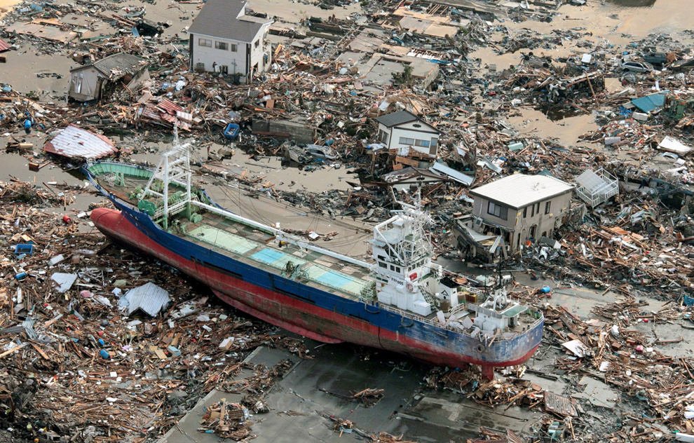

EARTH 270 – DISASTERS AND NATURAL HAZARDS (v. 2018)
Kensennuma City, Miyagi Prefecture , Japan, March 2011
PROFESSOR S.G. EVANS, PhD, PEng (Room 303, Earth Science and Chemistry (ESC) Building)

Slide 2
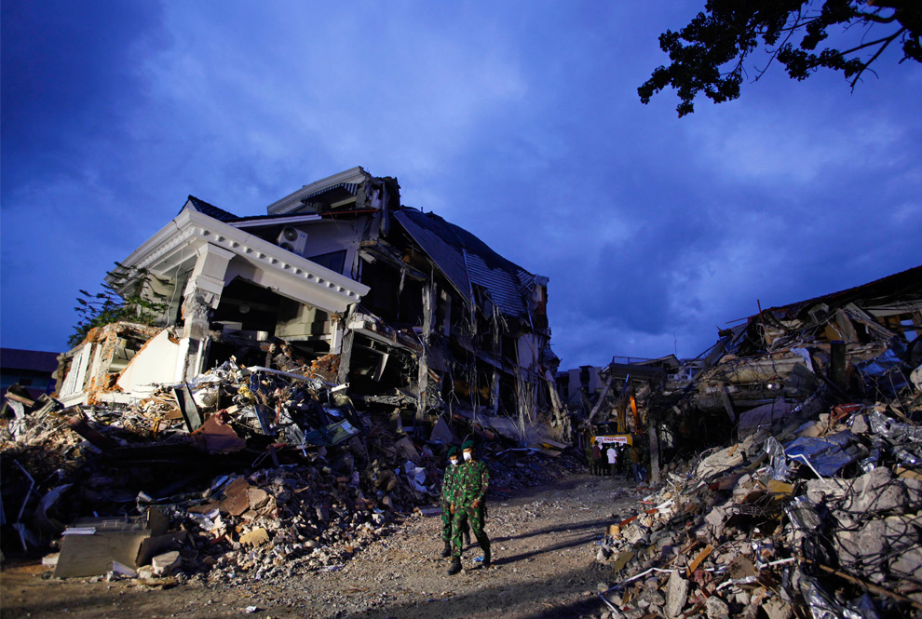
EARTHQUAKE HAZARD AND RISK

Slide 3
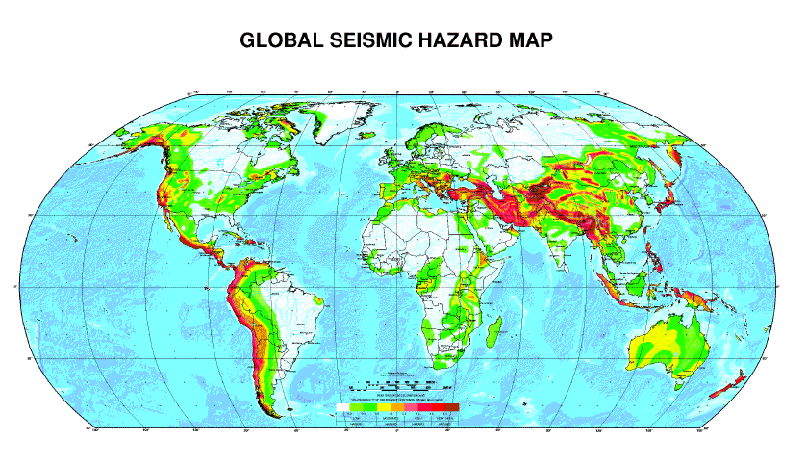

Slide 4
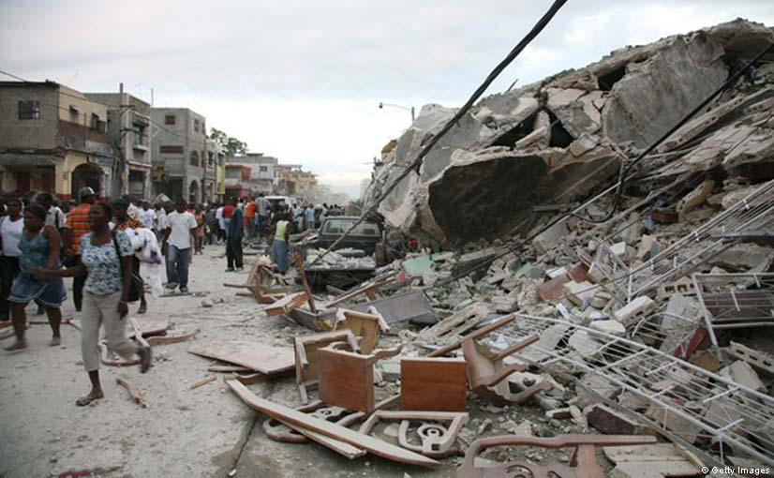
DATA REQUIRED FOR SEISMIC HAZARD ASSESSMENT
EARTHQUAKE TIMING
EARTHQUAKE MAGNITUDE
EARTHQUAKE LOCATION
COMPLETE EARTHQUAKE CATALOGUE OVER TIME INTERVAL BEING CONSIDERED [TIME INTERVAL VARIES; THE PROBLEM OF MISSING HIGH-MAGNITUDE INFREQUENT EVENTS]
FOR A GIVEN EARTHQUAKE, CALCULATION OF PEAK GROUND ACCELERATION FROM ATTENUATION RELATION FOR LOCATION CONSIDERED [TO QUANTIFY SEVERITY OF GROUND SHAKING]

Slide 5
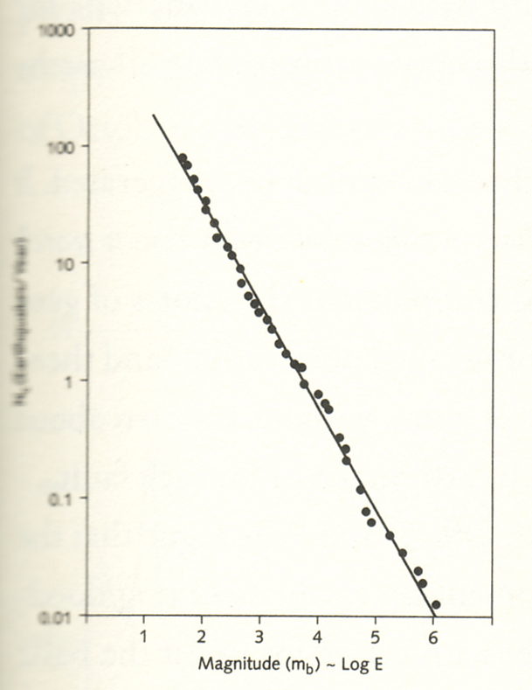
PATTERNS OF OCCURRENCE IN TIME – POWER LAW RELATIONS; THE BASIS OF SEISMIC HAZARD ASSESSMENT
The concept of Magnitude (M) and Frequency (F)
Power Law form : F = aM^{-b} [NOTE VALUE OF EXPONENT IS NEGATIVE INDICATIVE OF INVERSE RELATION]
The Gutenburg-Richter relation
4. Smaller events are much more common than large events
FREQUENCY
MAGNITUDE

Slide 6
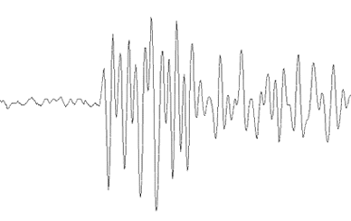
ASSESSMENT OF SEISMIC HAZARD BASED ON ANALYSIS OF EARTHQUAKE CATALOGUES
ANALYSIS OF MODERN INSTRUMENTAL CATALOGUES
DEVELOPMENT OF EARTHQUAKE HISTORIES (HISTORICAL DATA)
INVESTIGATION OF GEOLOGICAL EVIDENCE FOR PREHISTORIC EARTHQUAKE EVENTS

Slide 7
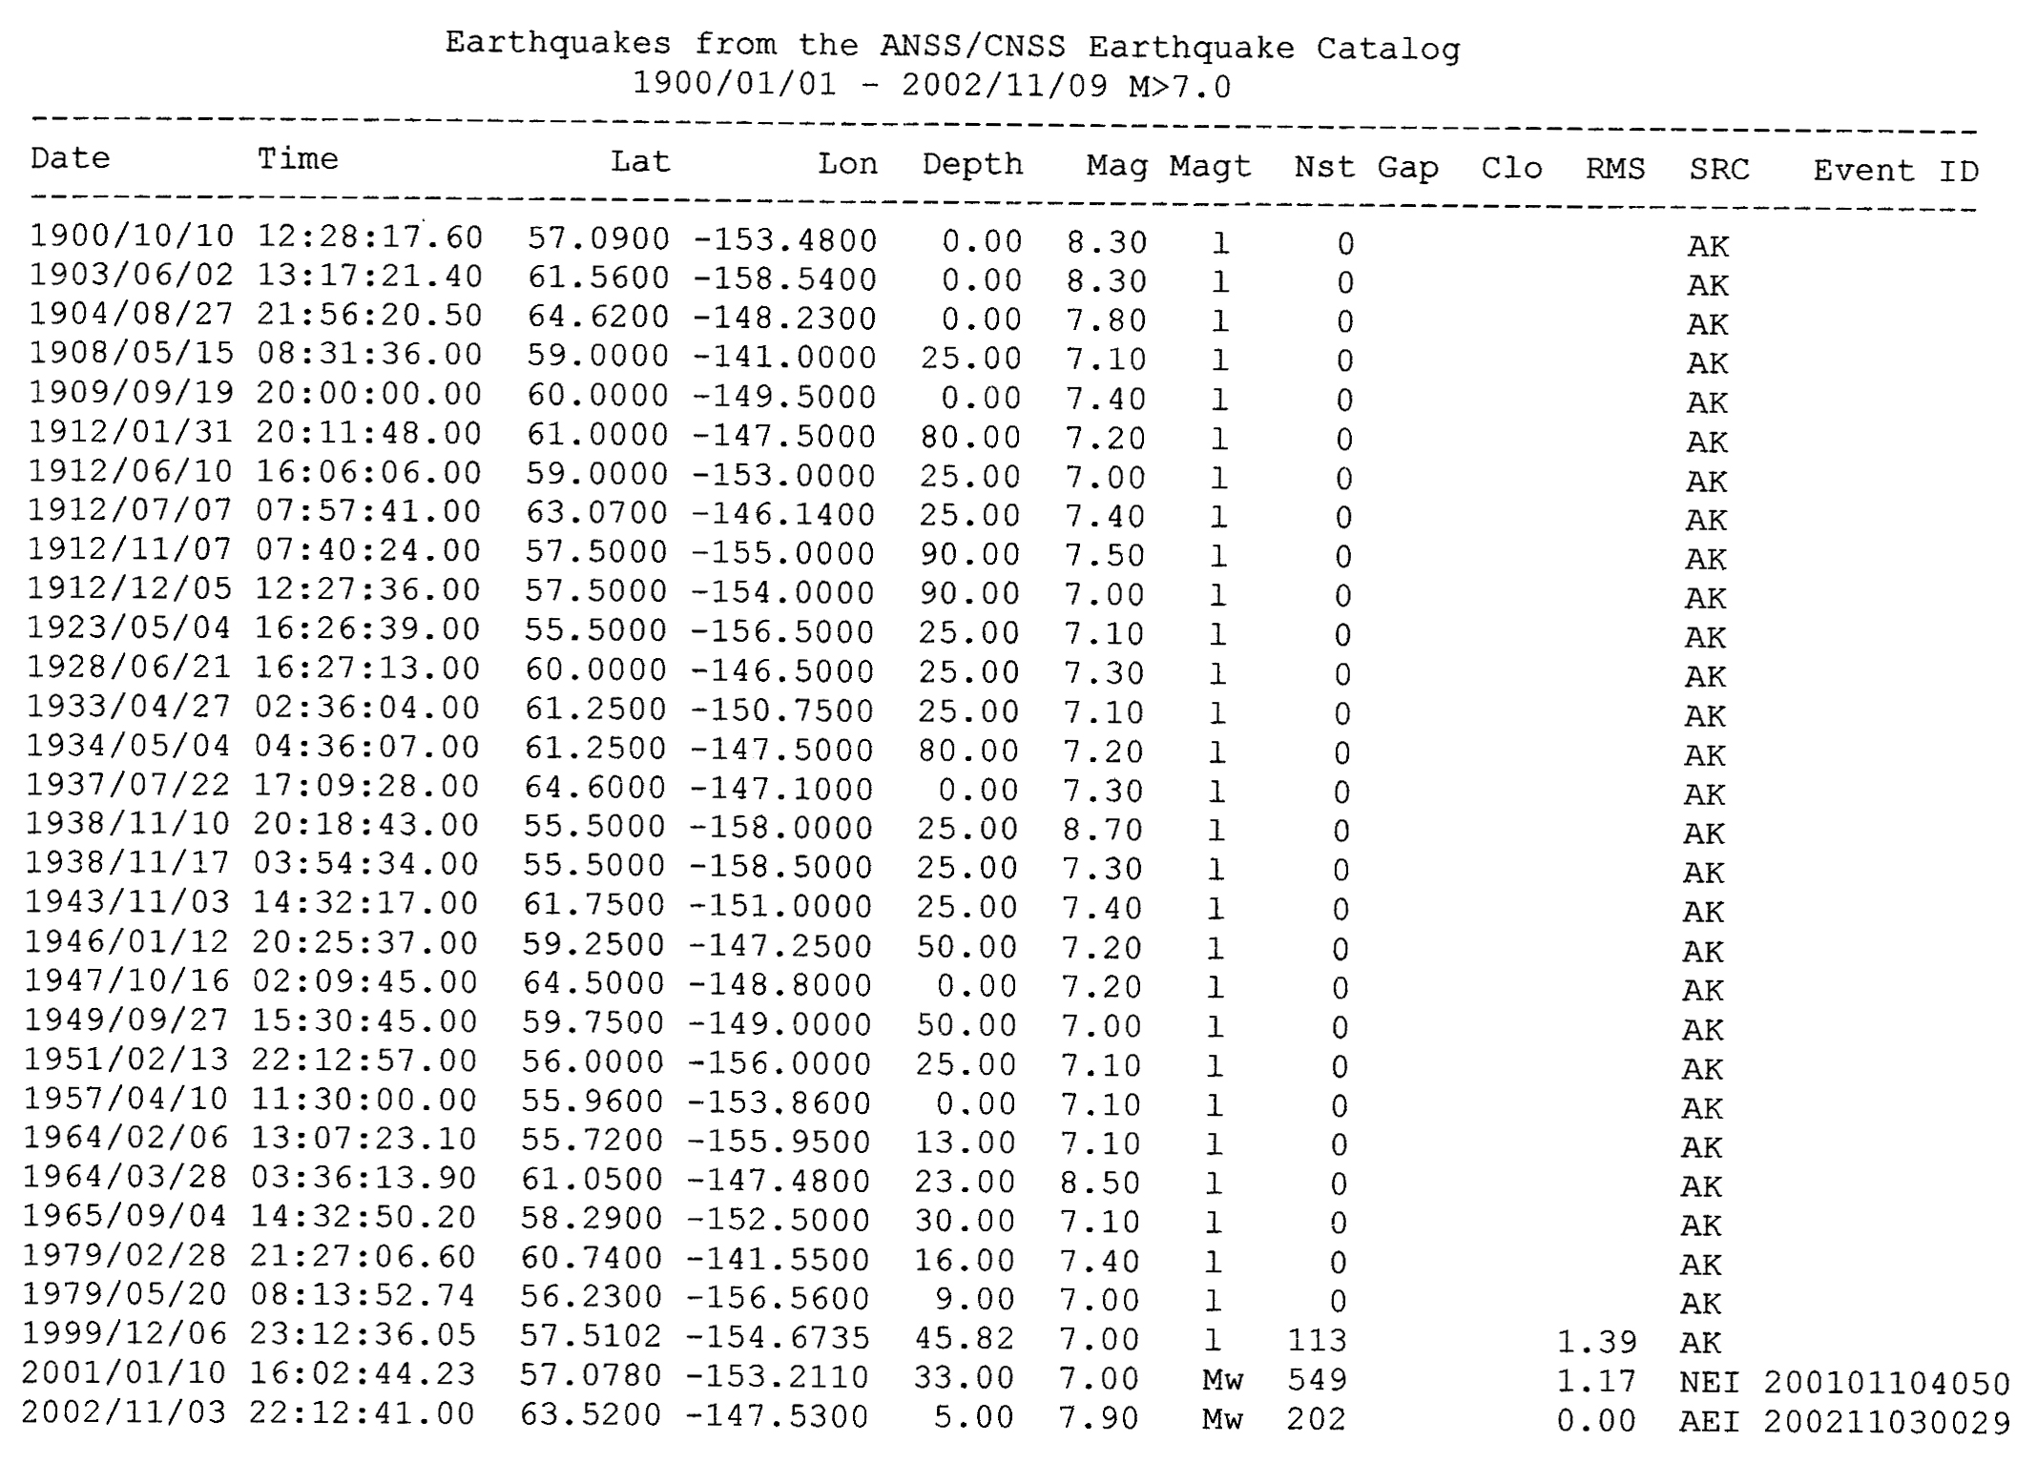
EXAMPLE OF INSTRUMENTAL EARTHQUAKE CATALOGUE - ALASKA

Slide 8
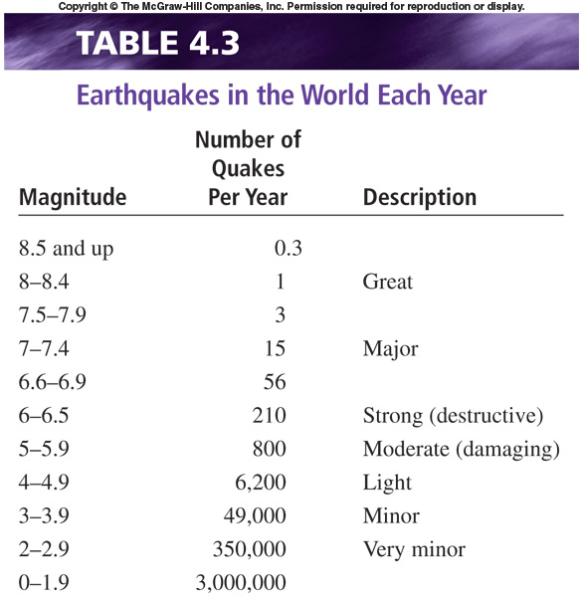
Table 4.3

Slide 9
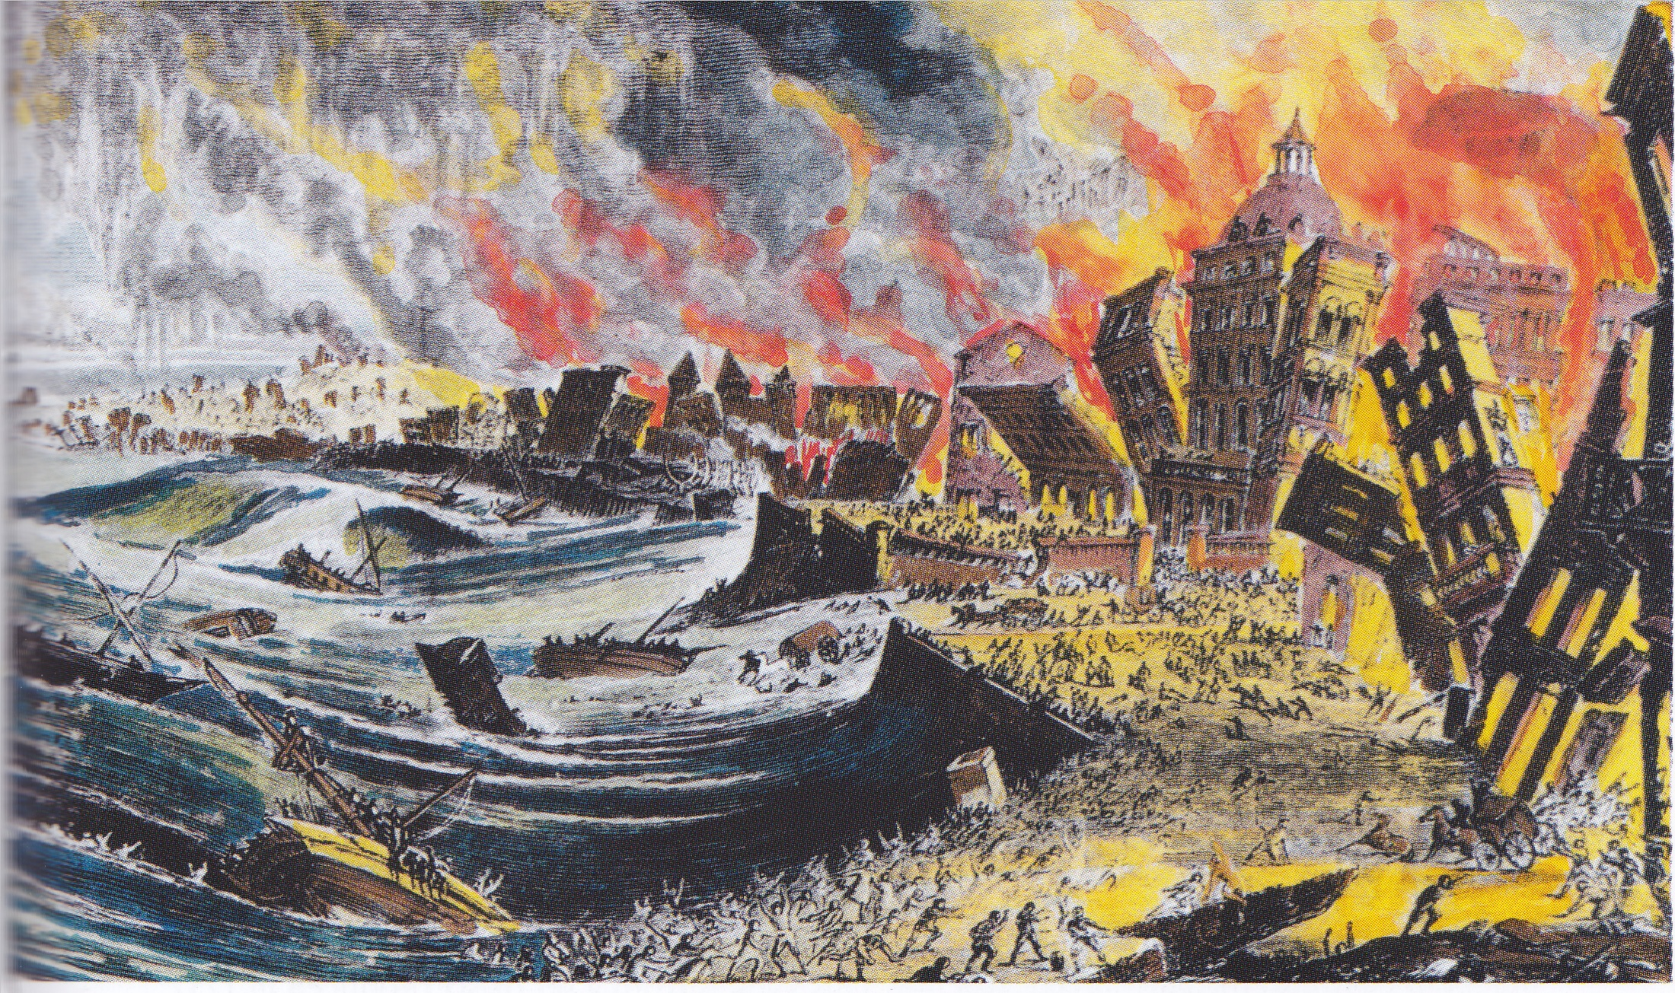
DEVELOPMENT OF EARTHQUAKE HISTORIES (HISTORICAL DATA)
Great Lisbon Earthquake 1755 (M8.7)

Slide 10
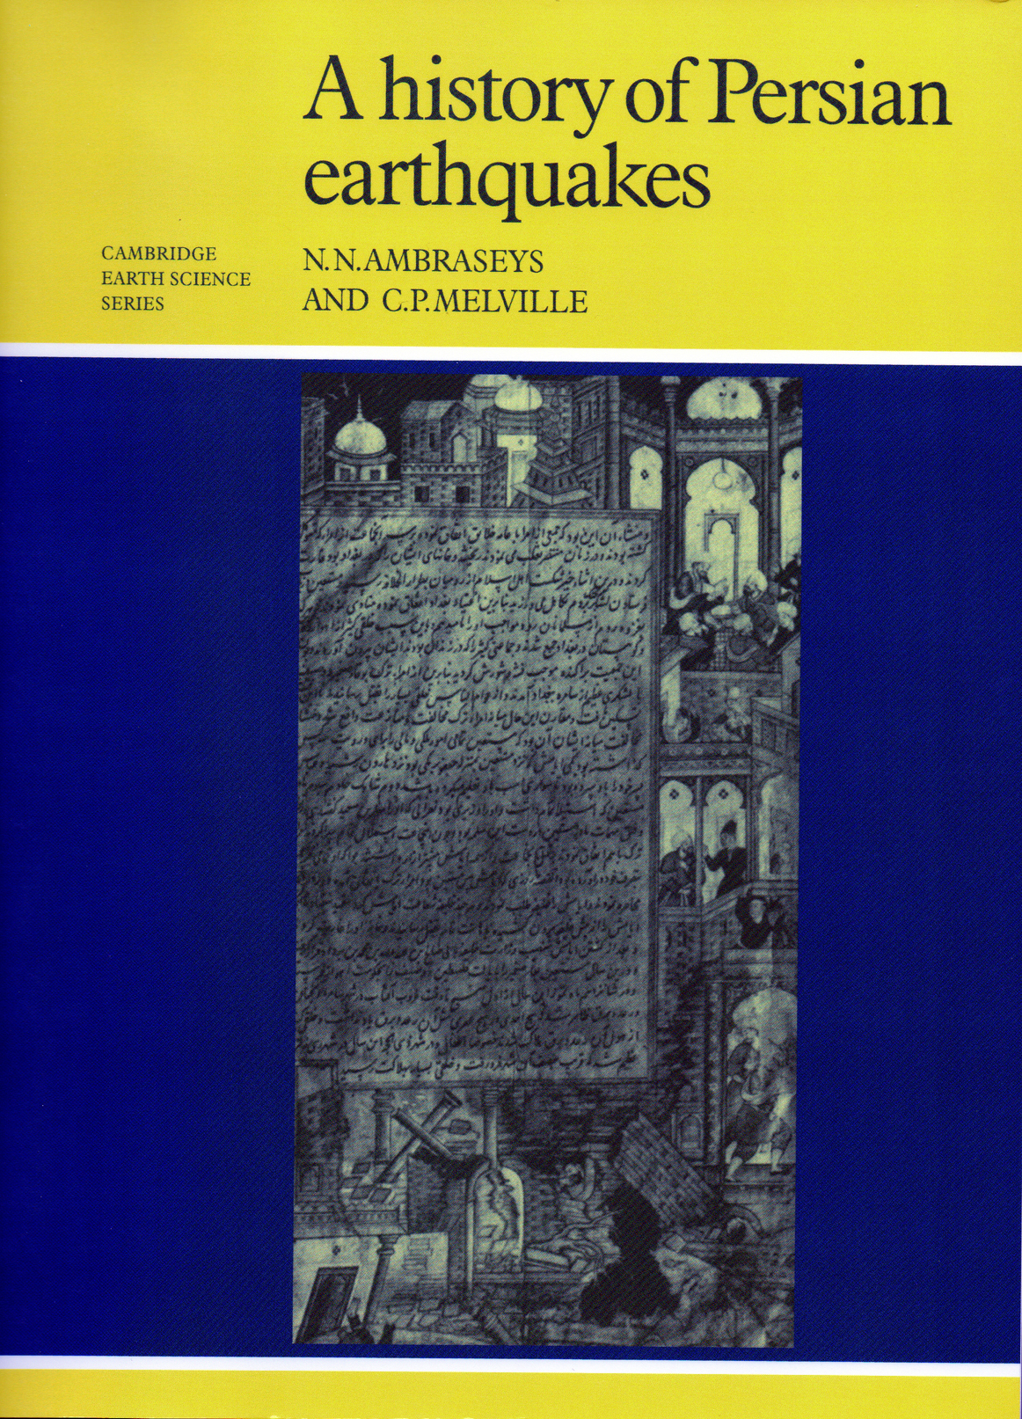
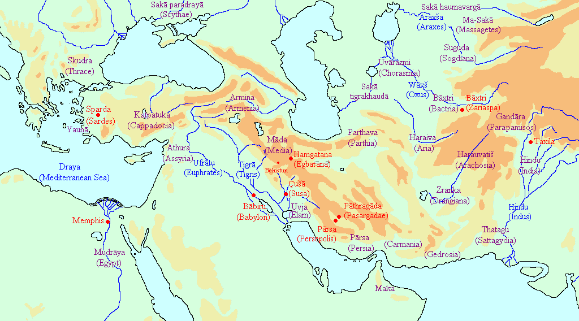
THE EXAMPLE OF PERSIA (IRAN)
628 - Present

Slide 11
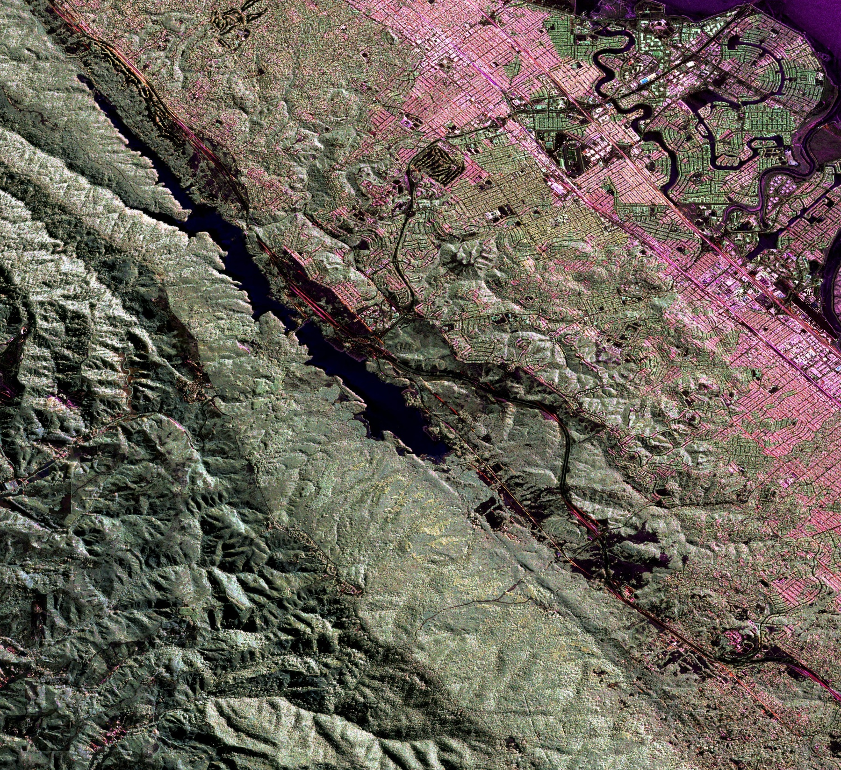
TRACE OF SAN ANDREAS FAULT JUST TO WEST OF SAN MATEO, CALIFORNIA; FAULT DEPRESSION IS PARTLY OCCUPIED BY CRYSTAL SPRINGS RESERVOIR [SITE IS JUST TO WEST OF SAN FRANCISCO AIRPORT]

Slide 12
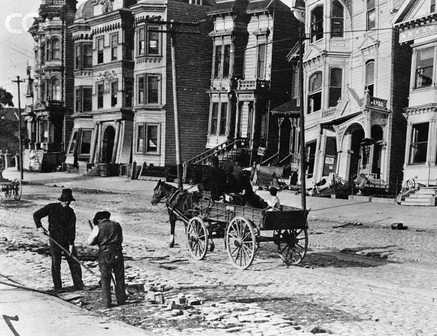
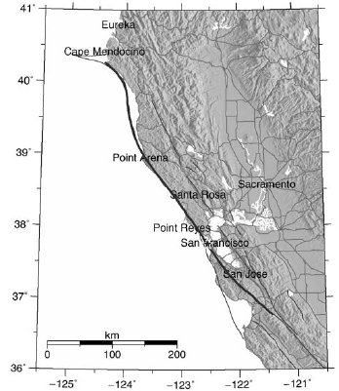
1906 SAN FRANCISCO EARTHQUAKE (M7.9) ; >3,000 DEATHS

Slide 13
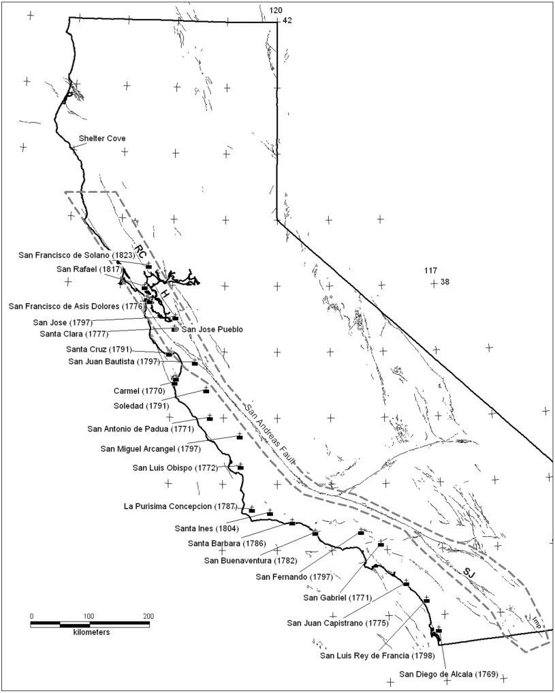

SPANISH MISSIONS ESTABLISHED IN CALIFORNIA IN EIGHTEENTH CENTURY

Slide 14
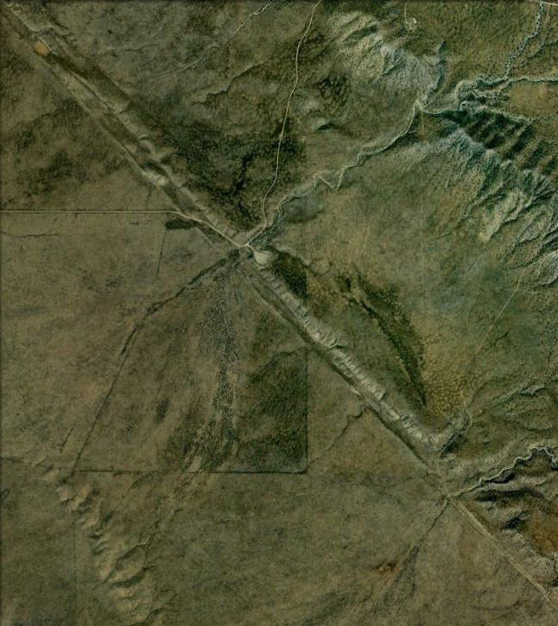
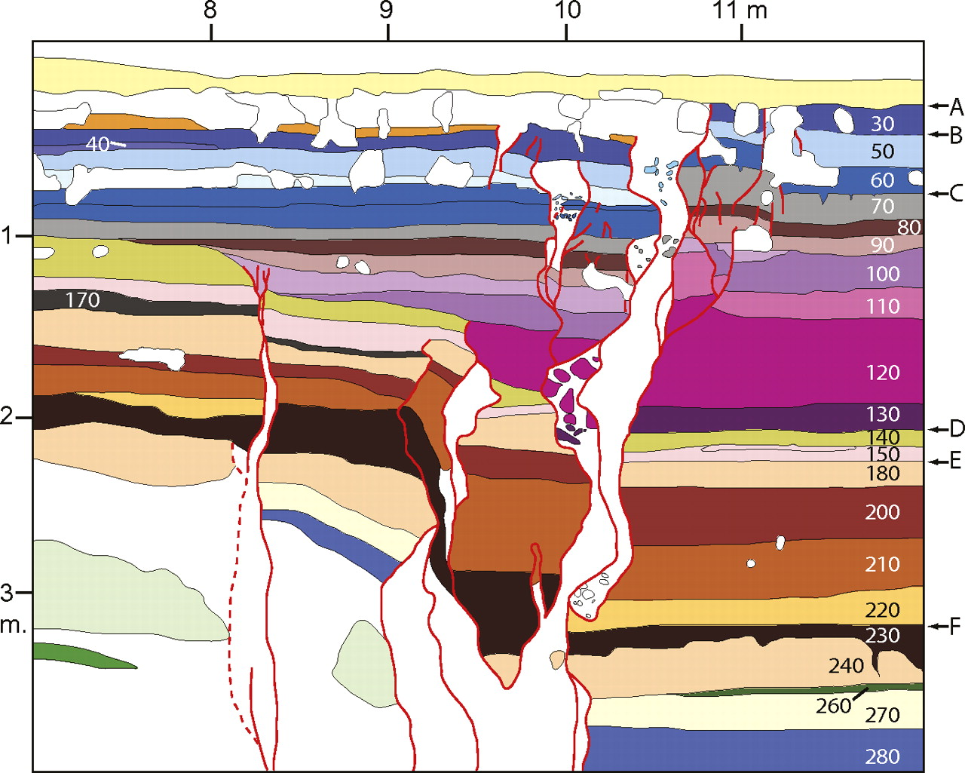
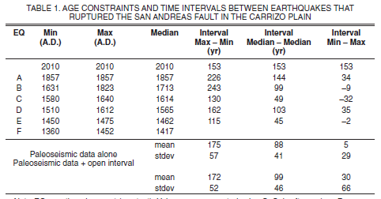
INVESTIGATION OF GEOLOGICAL EVIDENCE FOR PREHISTORIC EARTHQUAKE EVENTS

Slide 15
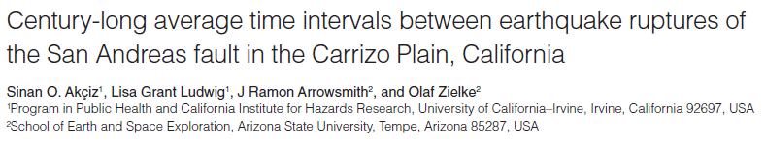
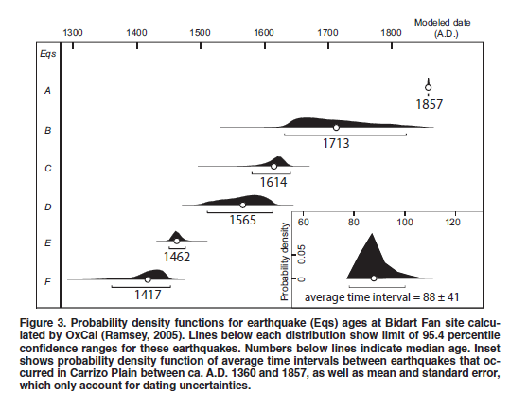

Slide 16
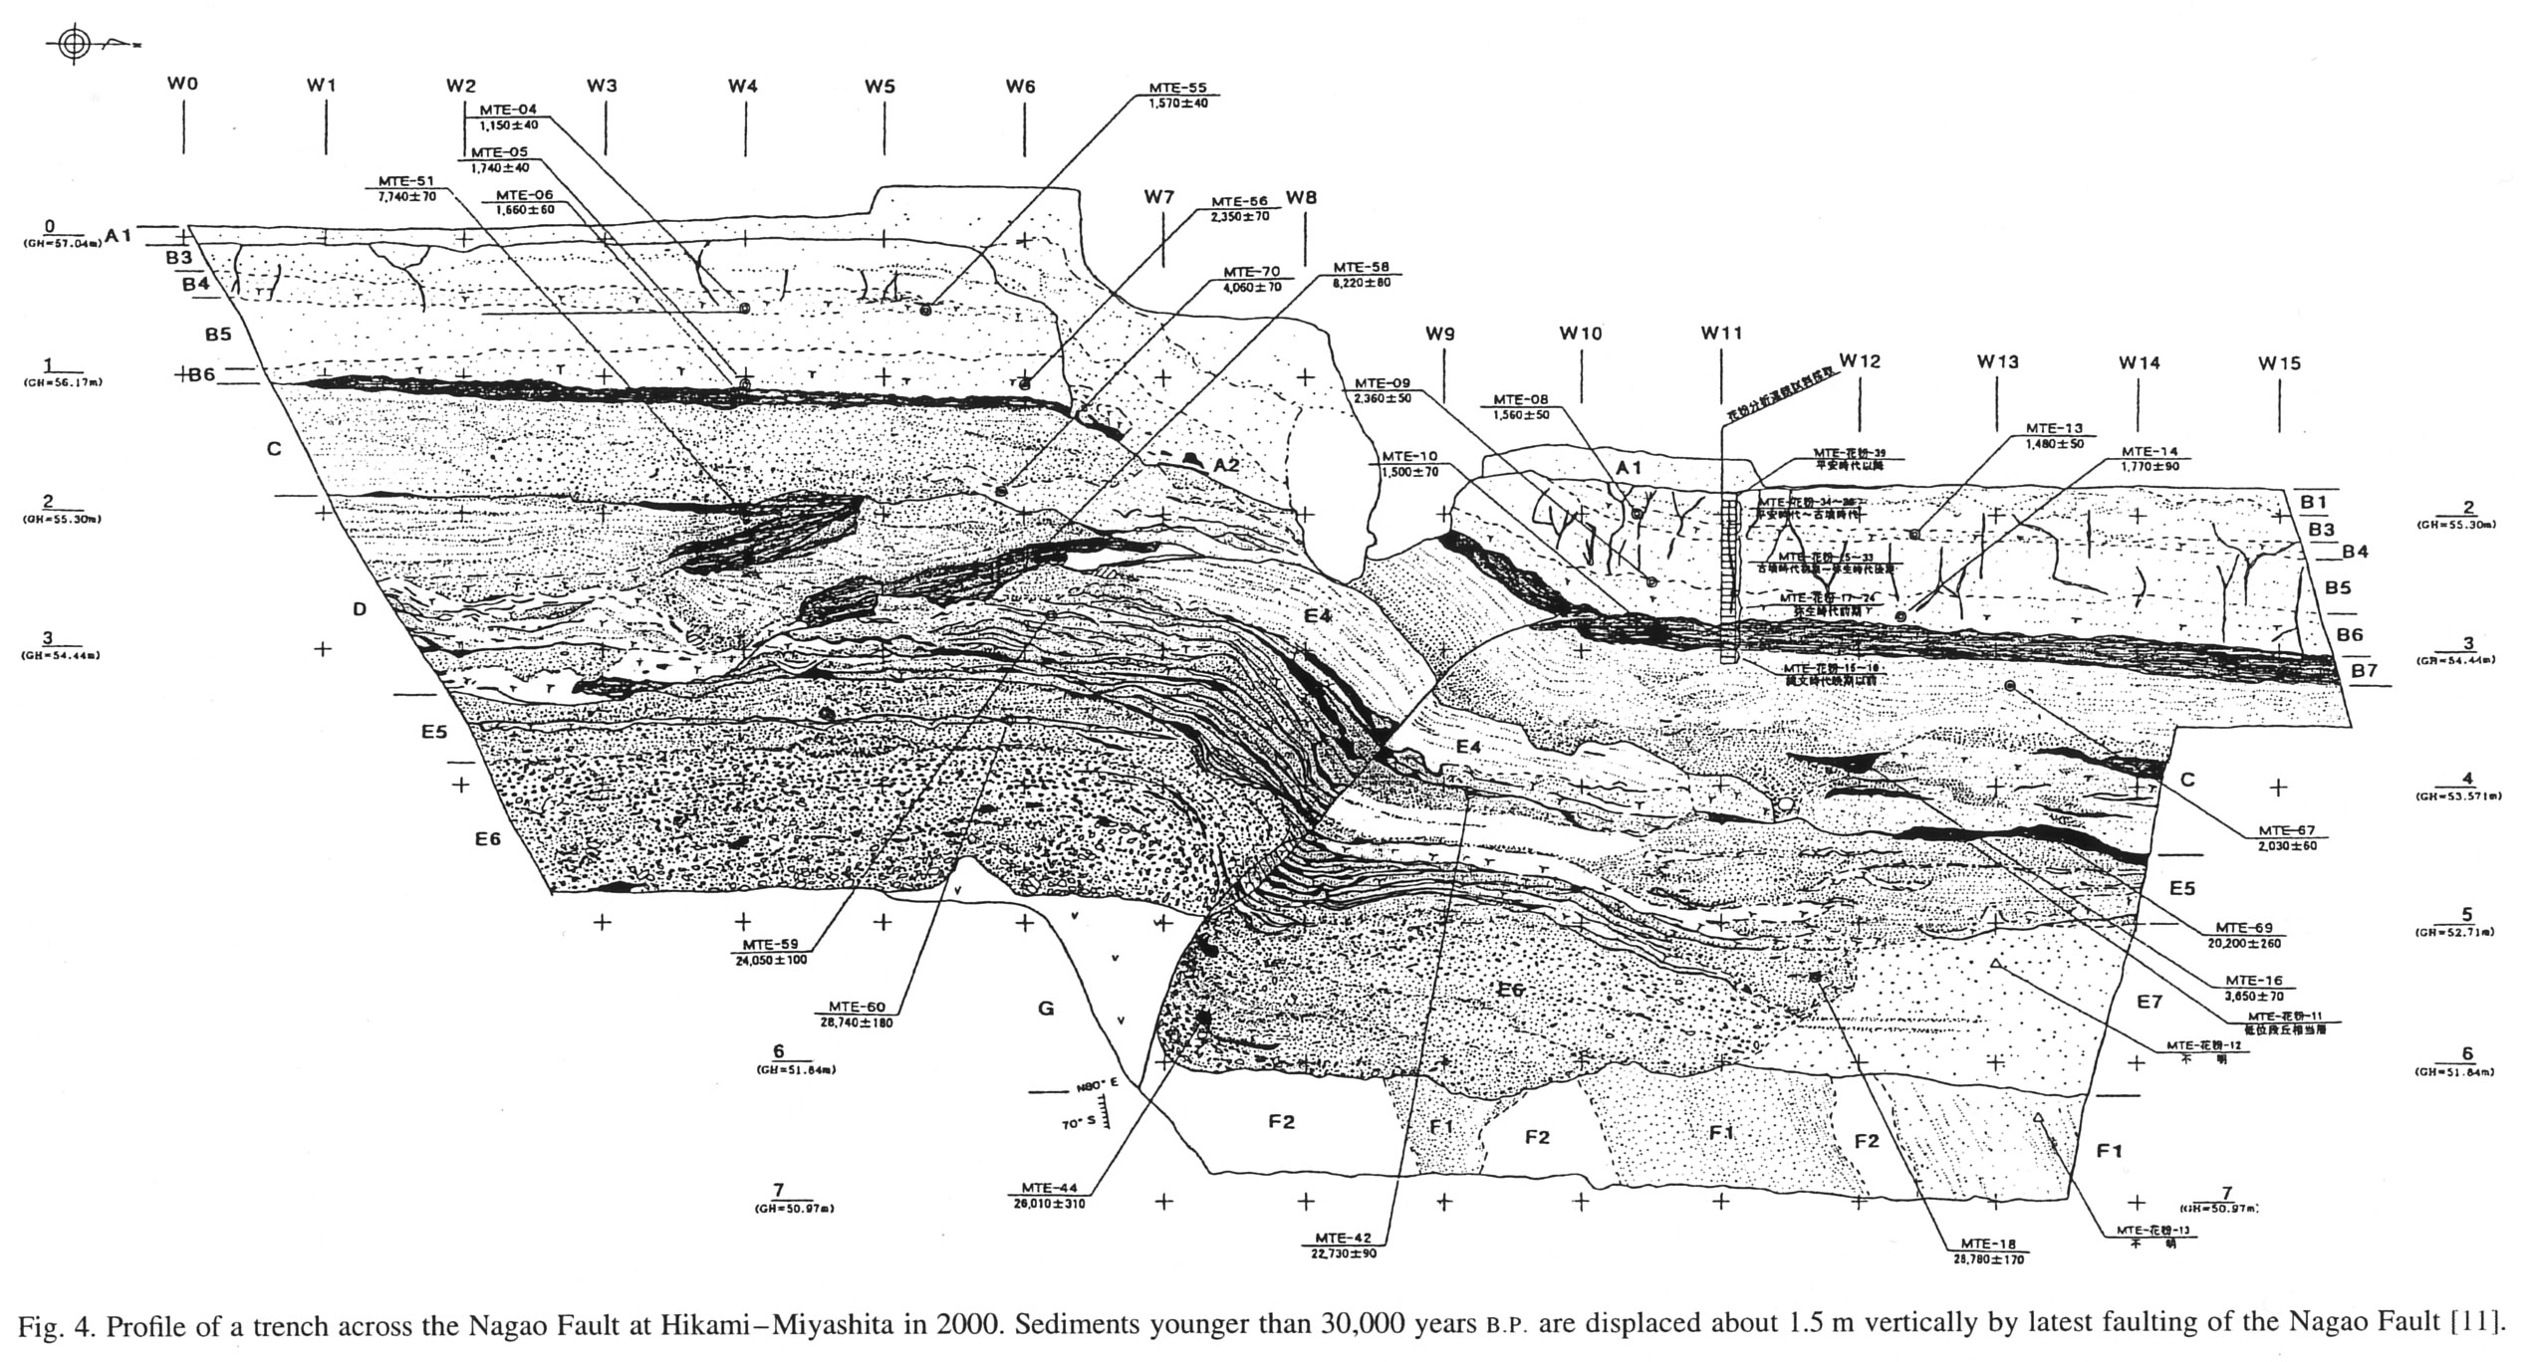
TRENCH ACROSS ACTIVE FAULT, SHIKUKU ISLAND, JAPAN

Slide 17
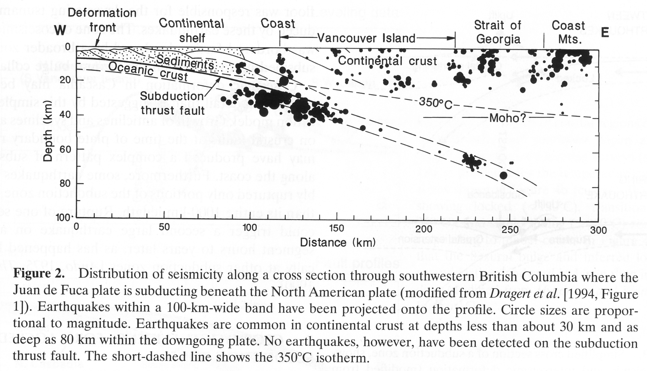
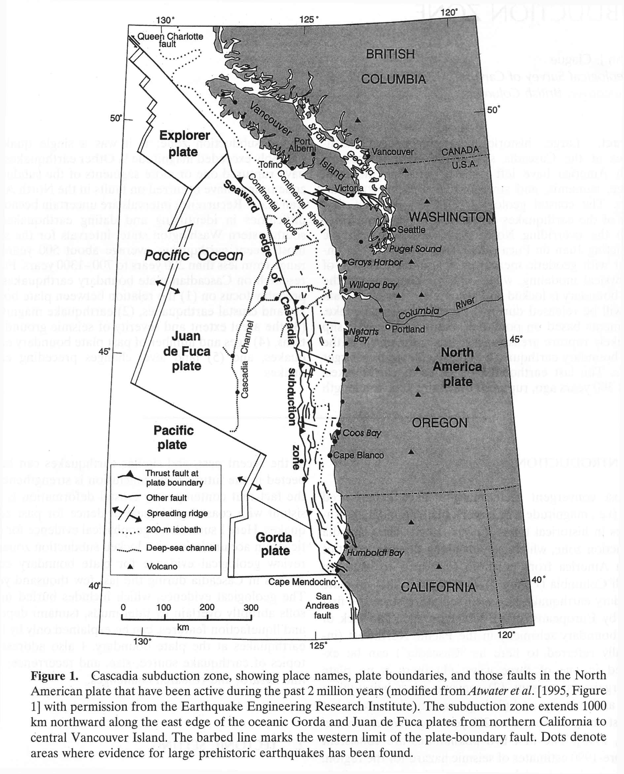
RECONSTRUCTING THE PREHISTORIC SEISMICITY OF THE CASCADIA SUBDUCTION ZONE ON GEOLOGICAL EVIDENCE

Slide 18
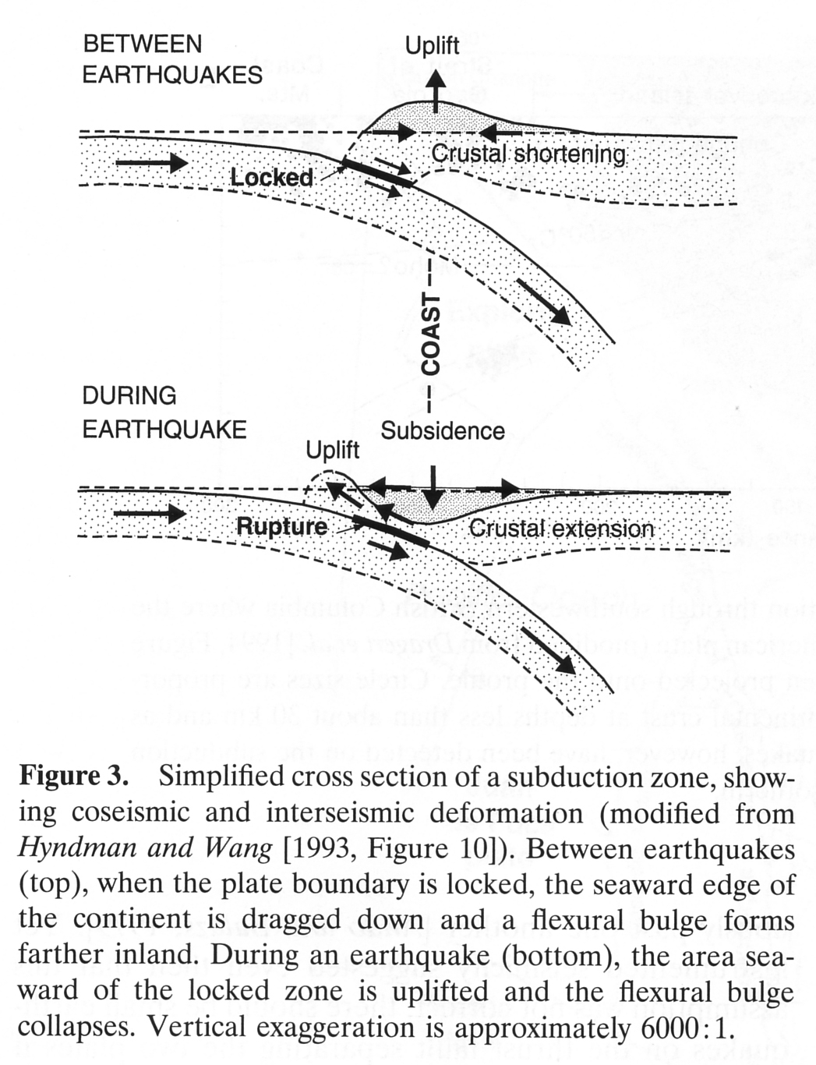
GEOPHYSICAL PROCESSES THAT GENERATE GEOLOGICAL EVIDENCE OF EARTHQUAKES AT THE COASTLINE ABOVE A SUBDUCTION ZONE

Slide 19
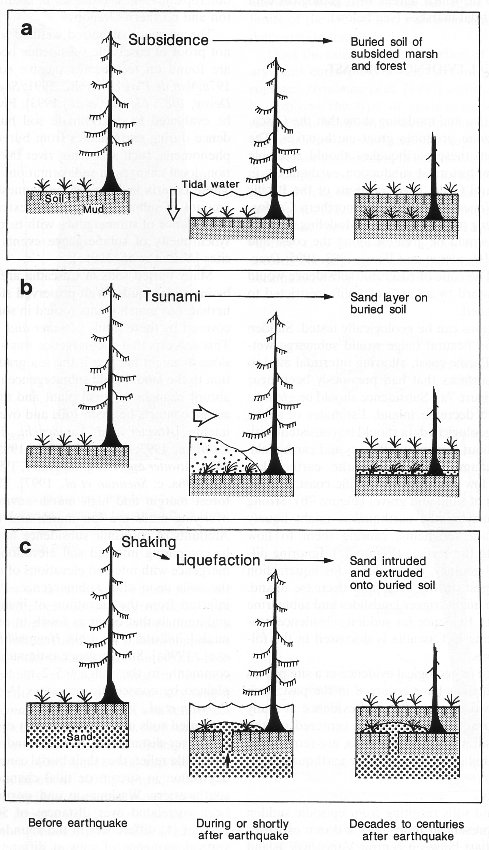
GEOLOGICAL EVIDENCE OF LARGE EARTHQUAKES IN COASTAL AREAS
SUBSIDENCE-buried wetlands soils resulting from episodic sudden subsidence, some abruptly overlain by tidal muds
TSUNAMI – some buried soils overlain by thin sheets of sand interpreted to be tsunami deposits
SHAKING (LIQUEFACTION) – features include dikes, sills, and blows

Slide 20
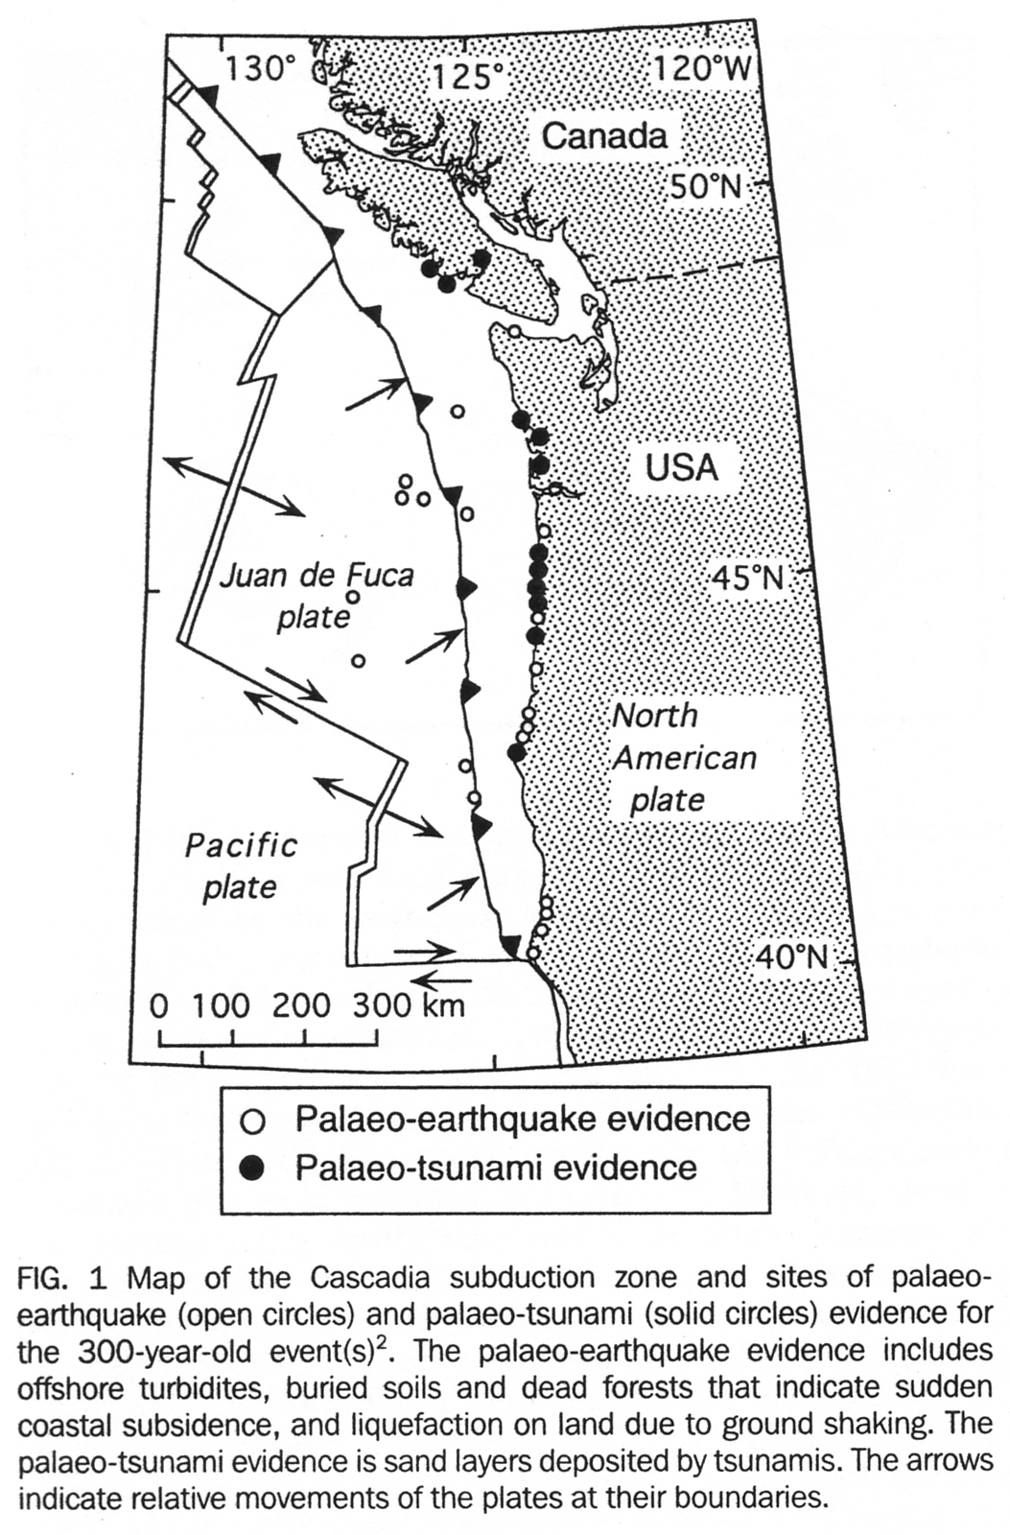
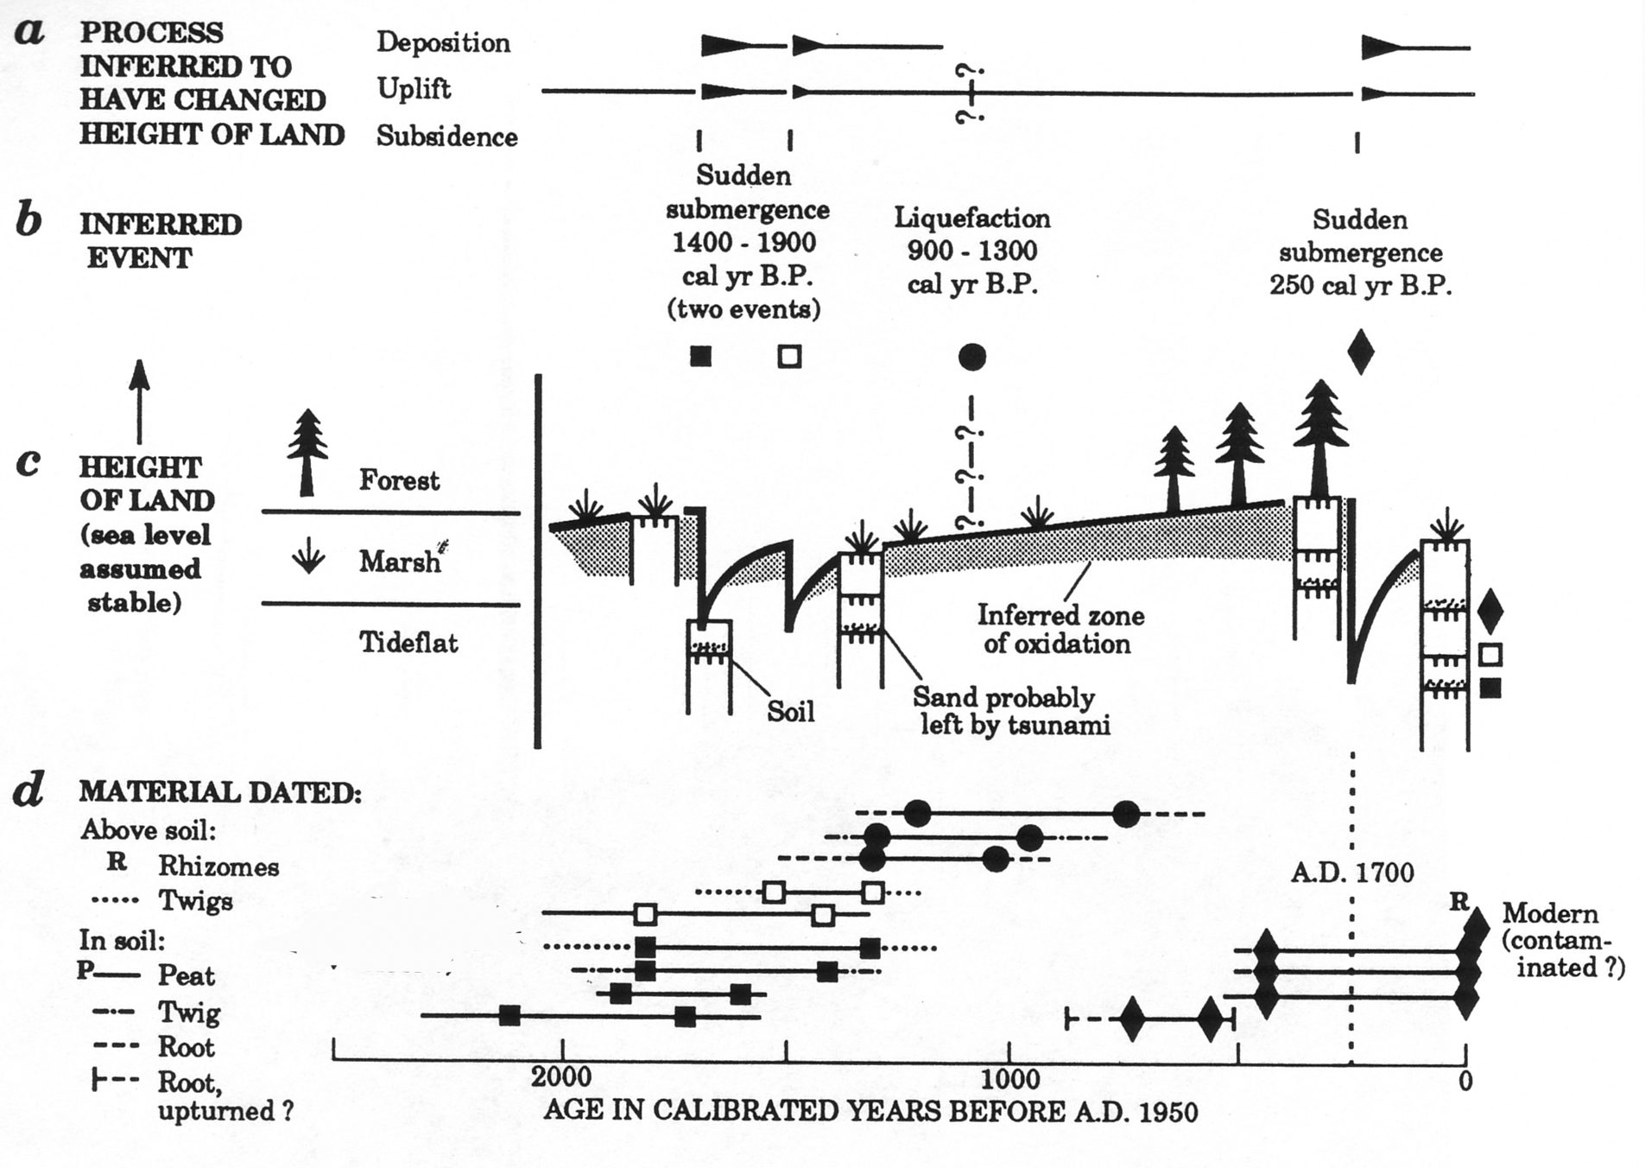
EVIDENCE FOR A MAJOR EARTHQUAKE ON THE CASCADIA SUBDUCTION ZONE, AROUND 1700 A.D.
GEOLOGICAL EVIDENCE ALONG THE COAST OF THE PACIFIC NORTHWEST
DENDROCHRONOLOGY (ANALYSIS OF TREE RINGS)

Slide 21

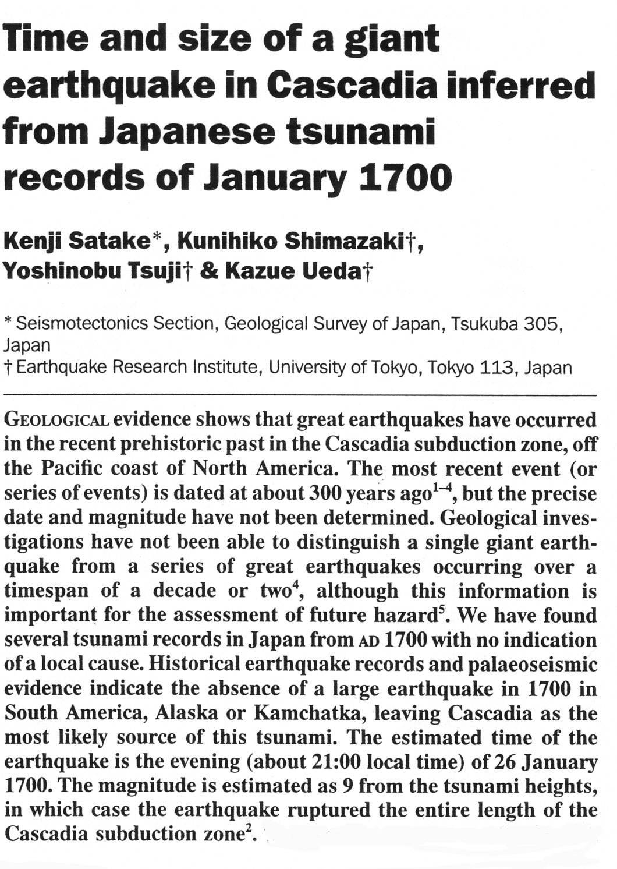
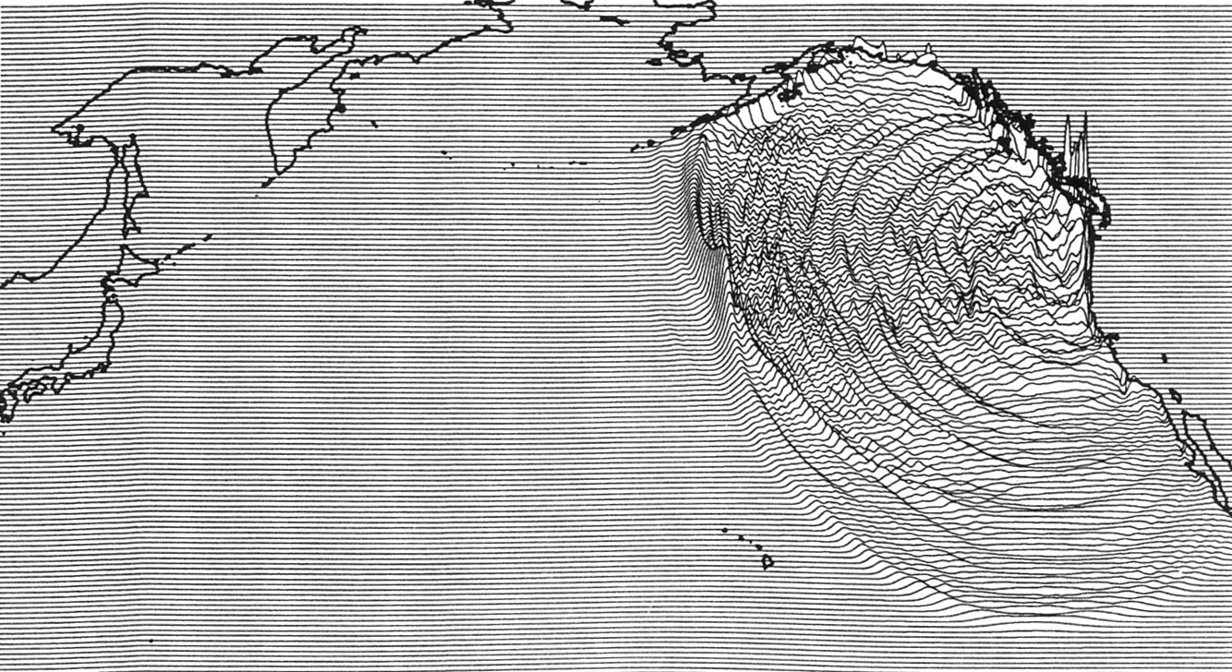
EVIDENCE FOR A MAJOR EARTHQUAKE ON THE CASCADIA SUBDUCTION ZONE, JANUARY 26, 1700 – EXACT DATING ACHIEVED.

Slide 22
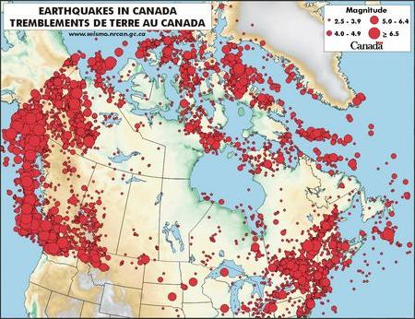

Slide 23
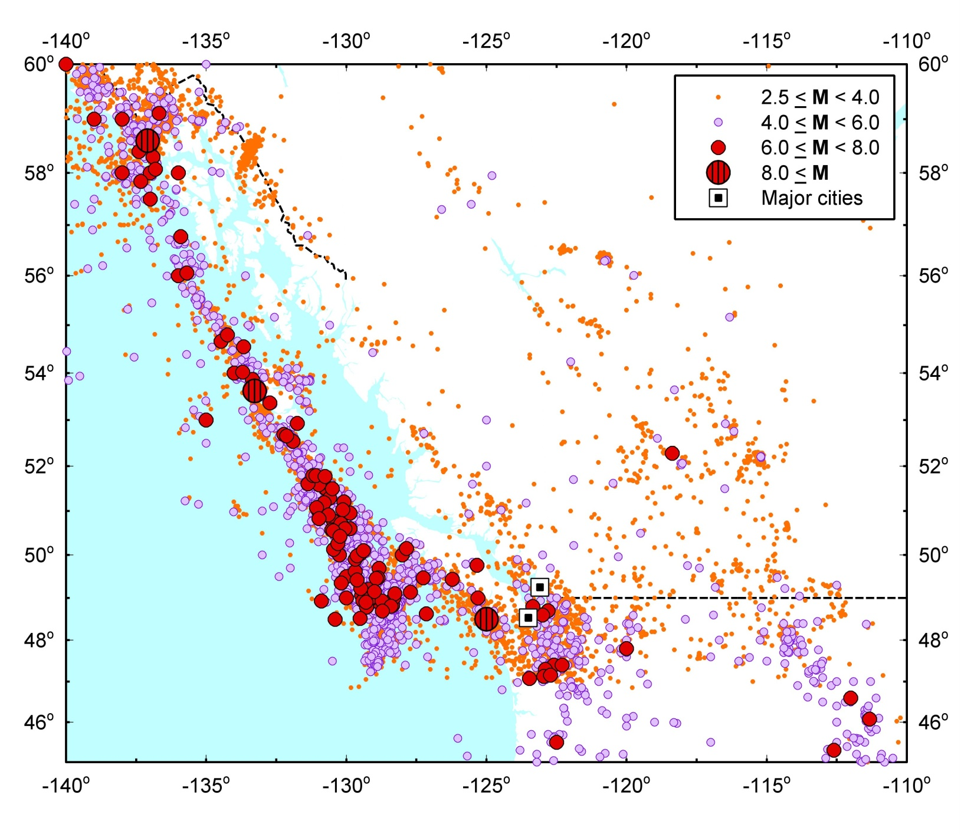
Vancouver
Victoria

Slide 24
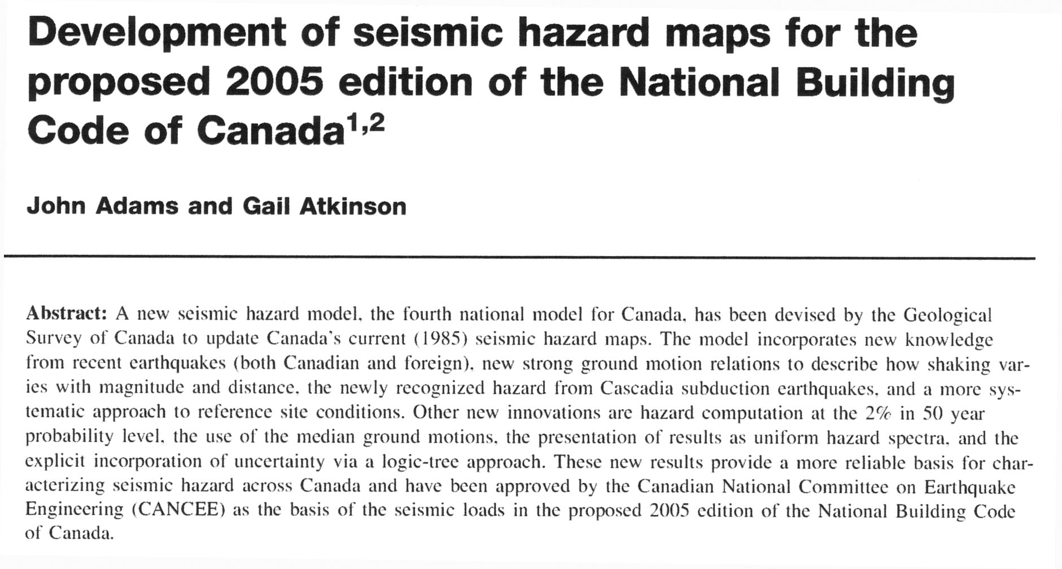
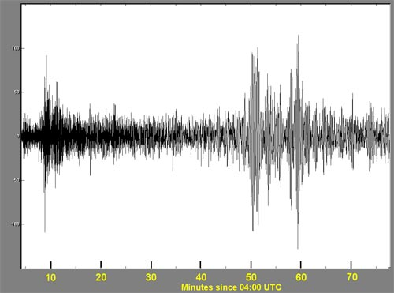
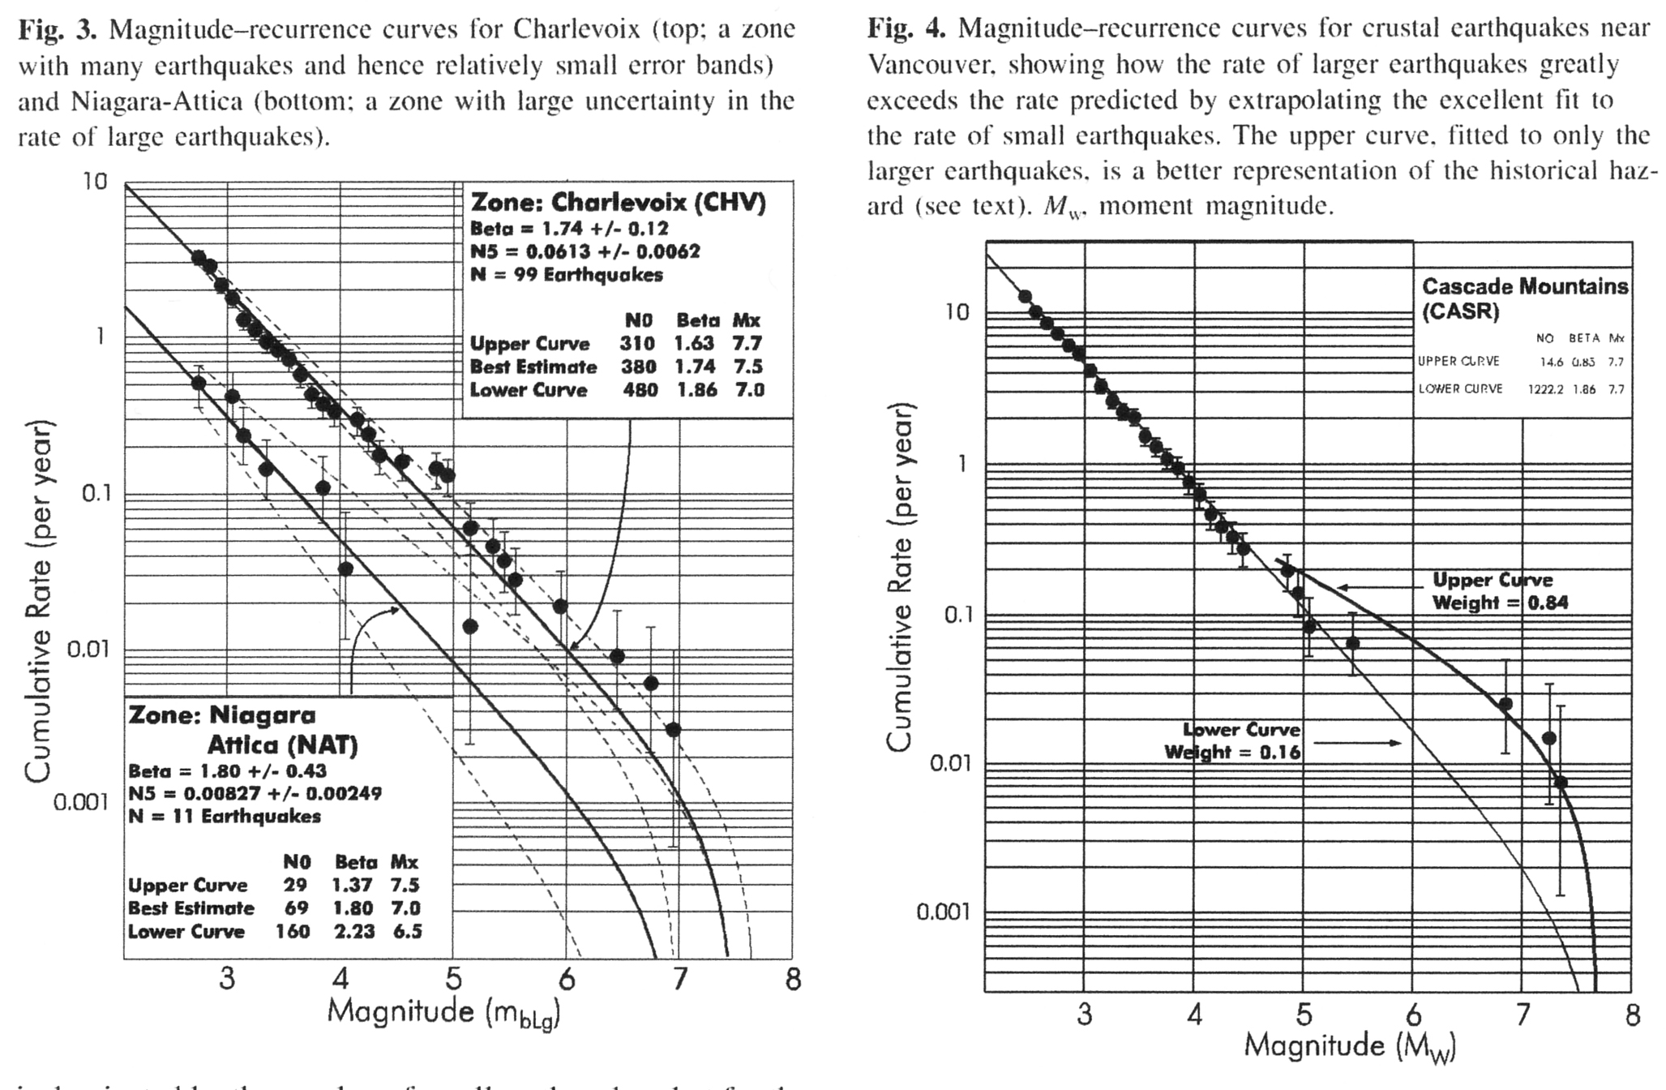

Slide 25
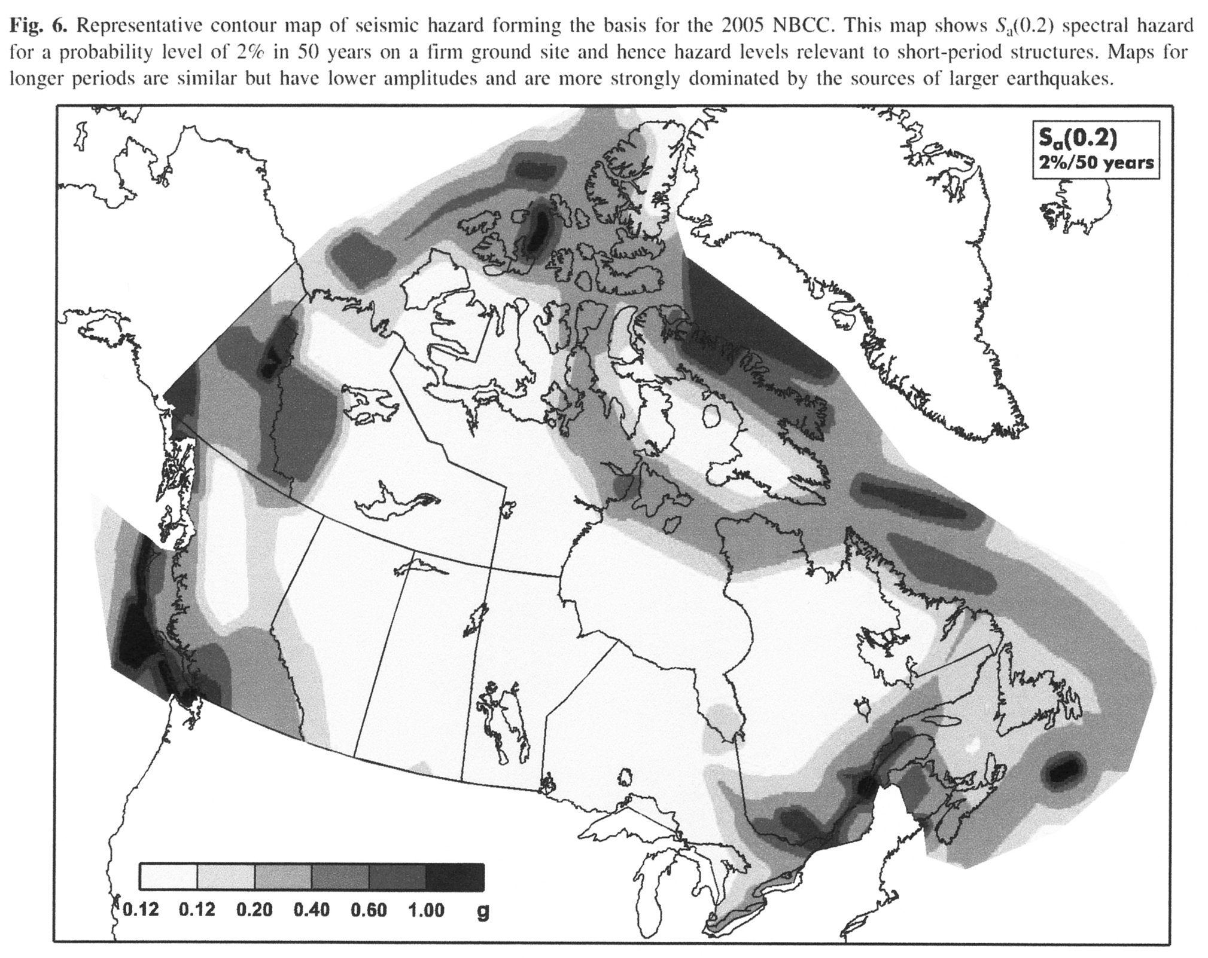

Slide 26
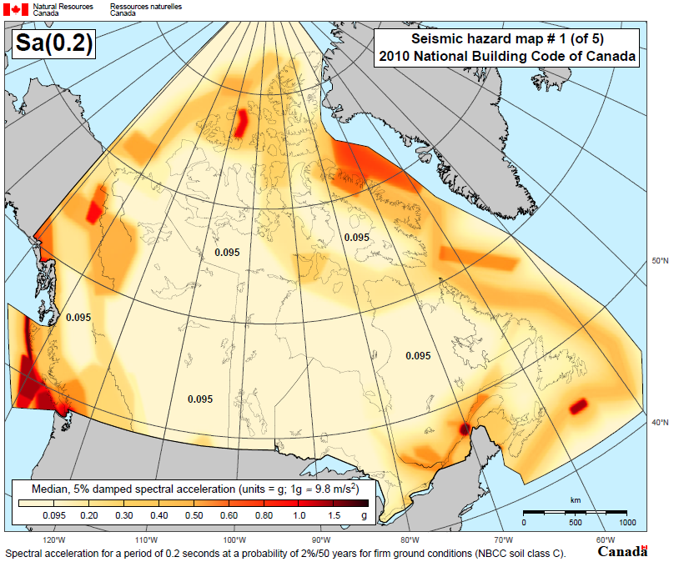

Slide 27
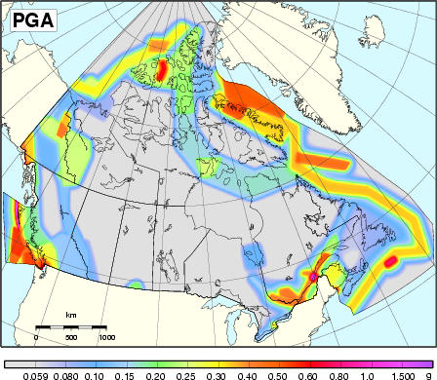

Slide 28
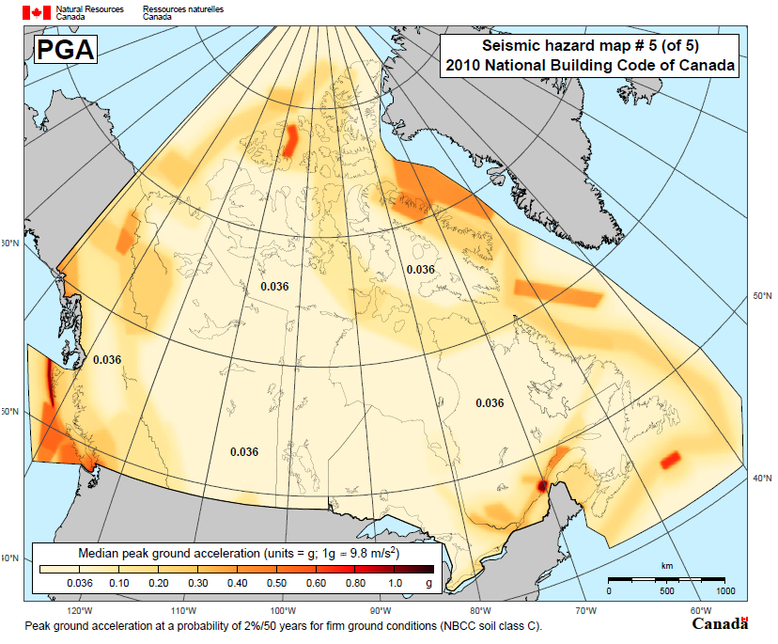

Slide 29
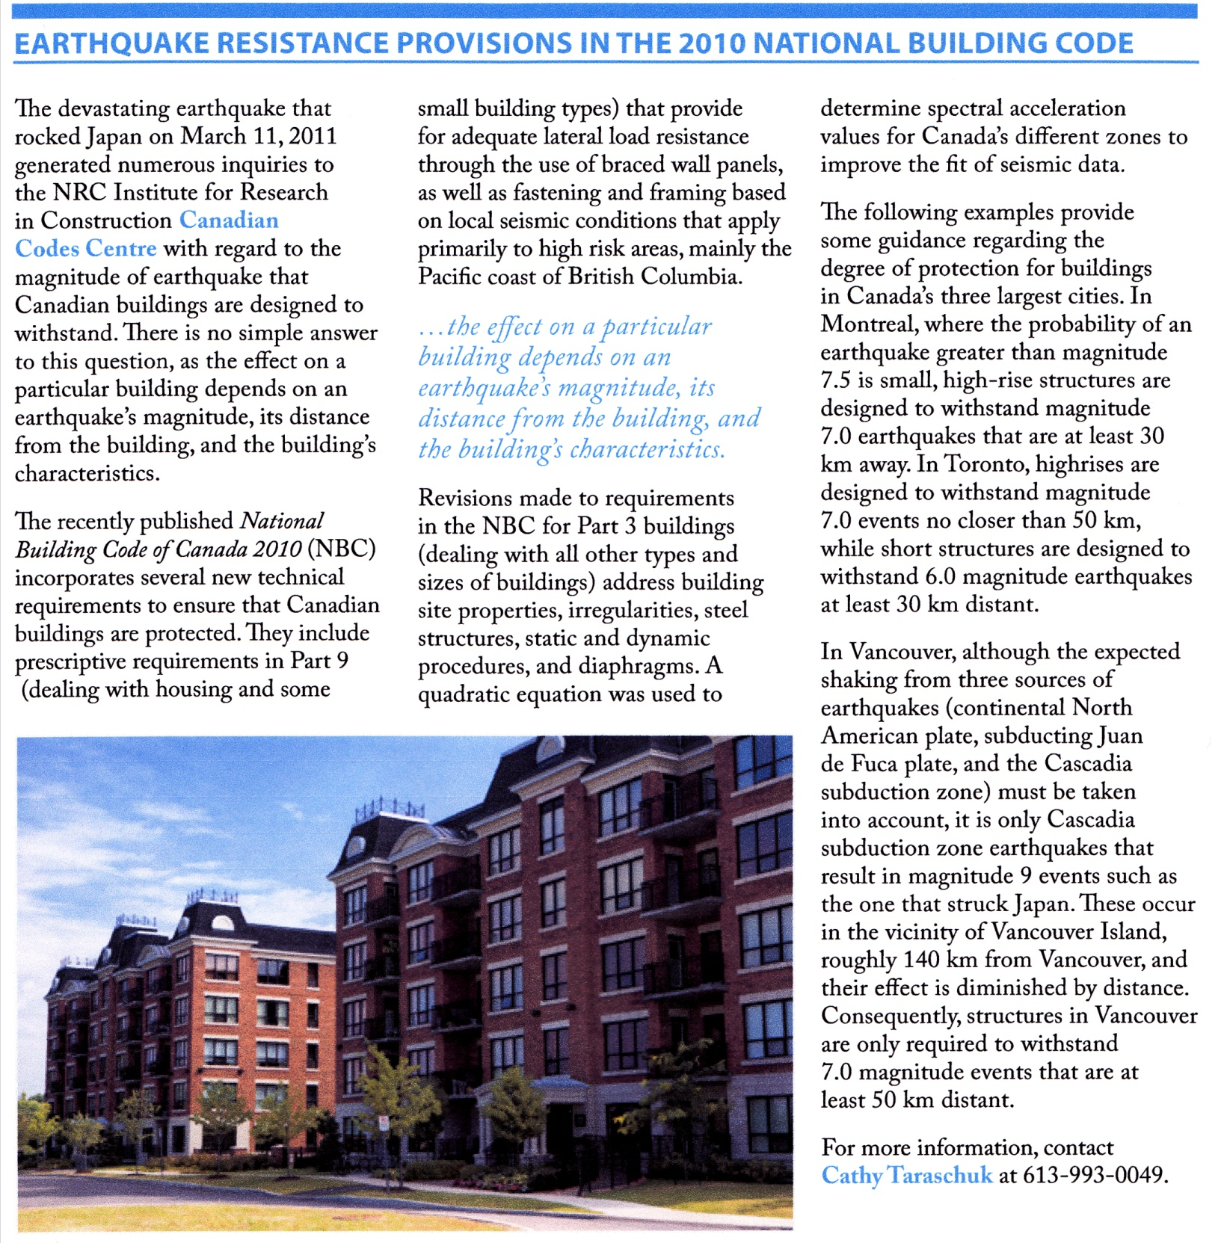

2010 CANADA NATIONAL BUILDING CODE

Slide 30

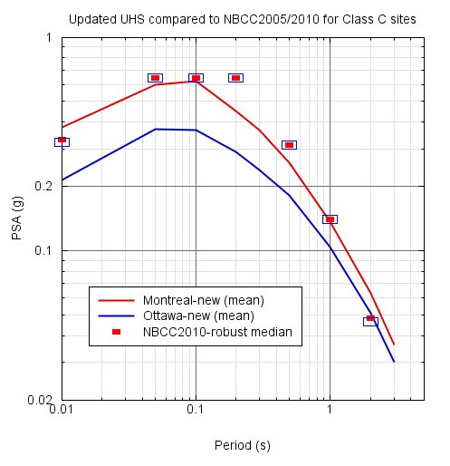
Updated Seismic Hazard Assessment – combining all factors Montreal and Ottawa (Atkinson and Goda, 2011)
Updated seismic hazard estimates (mean UHS) for Montreal are lower than given in 2005/2010 NBCC at short periods, slightly larger at long periods
Updated mean-hazard UHS for Ottawa significantly lower than 2005/2010 NBCC at most periods
SLIDE COURTESY OF PROF. GAIL ATKINSON, WESTERN

Slide 31
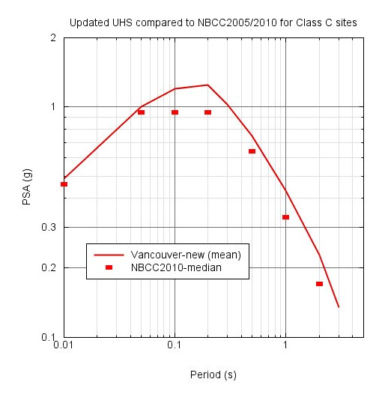
Updated Seismic Hazard Assessment – Vancouver (Atkinson and Goda, 2011)
Updated seismic hazard estimates for Vancouver (mean-hazard) exceeds 2005/2010 NBCC by a modest amount
SLIDE COURTESY OF PROF. GAIL ATKINSON, WESTERN

Slide 32
EARTHQUAKE DISASTERS

Slide 33
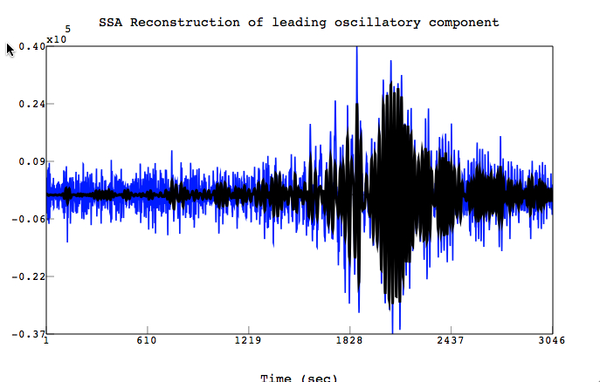
WHAT IS AN EARTHQUAKE DISASTER ?
EARTHQUAKE
RESISTANCE
EXPOSED POPULATION
LIFE LOSS

Slide 34
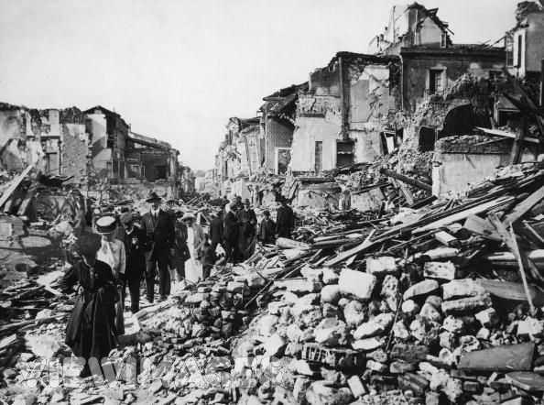
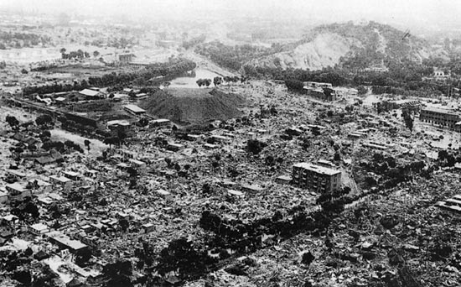
EARTHQUAKE DISASTERS (>50,000 DEATHS) 856-2010 (n = 22)
1 | 1566 | Shaanxi, China (M~8.0) | 830000
2 | 1976 | Tangshan, China (M7.5) | 255,000
3 | 1138 | Aleppo, Syria (strike slip) | 233,000
4 | 2010 | Haiti (M7.0 – strike slip) | 230,000
5 | 2004 | Sumatra (M9.1 - megathrust) | 227,898
6 | 856 | Damghan, Iran (strike slip) | 200,000
7 | 1920 | Haiyuan, China (M8.6 – strike slip) | 200,000
8 | 893 | Ardabil, Iran | 150,000
9 | 1923 | Kanto, Japan (M7.9) | 142,800
10 | 1948 | Ashkhabad, Turkmenistan (M7.3) | 110,000
11 | 1290 | Chihli, China | 100,000
12 | 2008 | Wenchuan, China (M7.9) | 87,587
13 | 2005 | Pakistan (M7.6) | 86,000
14 | 1667 | Caucasus (Shemakha, Azerbaijan) | 80,000
15 | 1727 | Tabriz, Iran | 77,000
16 | 1908 | Messina, Italy (M7.2) | 72,000
17 | 1755 | Lisbon, Portugal (M8.7) | 70,000
18 | 1970 | Chimbote, Peru (M7.9 – subduction) | 70,000
19 | 1268 | Asia Minor (Cilicia) | 60,000
20 | 1693 | Sicily (M7.5) | 60,000
21 | 1783 | Calabria, Italy (sequence) | 50,000
22 | 1990 | W. Iran (M7.4) | 50,000
 |  |  | 3441285

Slide 35
LOCATION OF EARTHQUAKE DISASTERS (>50,000 DEATHS) 856-2010 (n = 22)

Slide 36
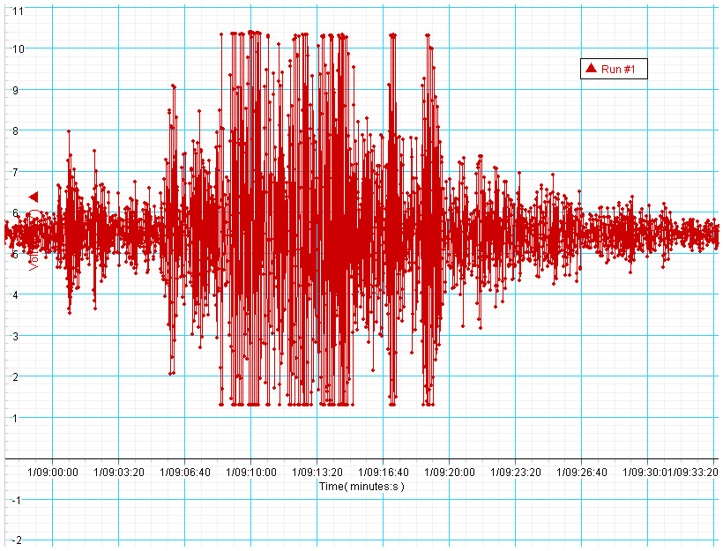
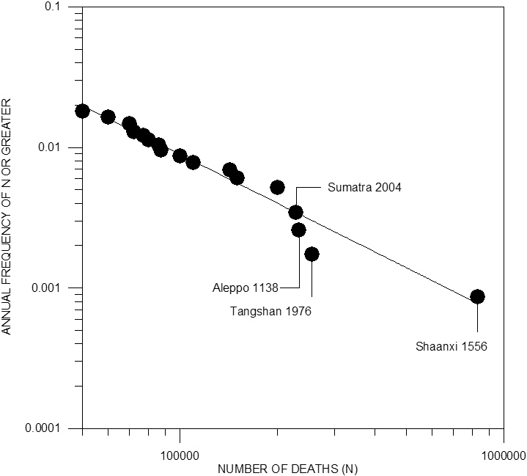

Slide 37
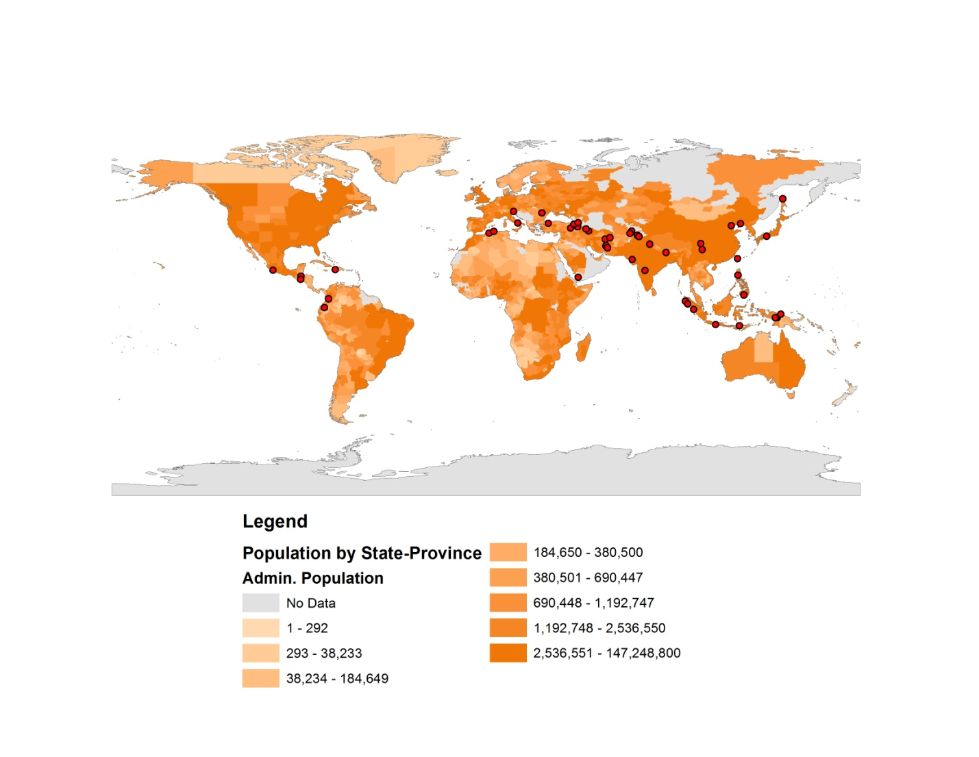
GLOBAL DISTRIBUTION OF EARTHQUAKE DISASTERS (>1,000 DEATHS) 1973-2010

Slide 38
EARTHQUAKE DISASTERS (>50,000 DEATHS) 856-2010 (n = 22)
1 | 1566 | Shaanxi, China (M~8.0) | 830000
2 | 1976 | Tangshan, China (M7.5) | 255,000
3 | 1138 | Aleppo, Syria (strike slip) | 233,000
4 | 2010 | Haiti (M7.0 – strike slip) | 230,000
5 | 2004 | Sumatra (M9.1 - megathrust) | 227,898
6 | 856 | Damghan, Iran (strike slip) | 200,000
7 | 1920 | Haiyuan, China (M8.6 – strike slip) | 200,000
8 | 893 | Ardabil, Iran | 150,000
9 | 1923 | Kanto, Japan (M7.9) | 142,800
10 | 1948 | Ashkhabad, Turkmenistan (M7.3) | 110,000
11 | 1290 | Chihli, China | 100,000
12 | 2008 | Wenchuan, China (M7.9) | 87,587
13 | 2005 | Pakistan (M7.6) | 86,000
14 | 1667 | Caucasus (Shemakha, Azerbaijan) | 80,000
15 | 1727 | Tabriz, Iran | 77,000
16 | 1908 | Messina, Italy (M7.2) | 72,000
17 | 1755 | Lisbon, Portugal (M8.7) | 70,000
18 | 1970 | Chimbote, Peru (M7.9 – subduction) | 70,000
19 | 1268 | Asia Minor (Cilicia) | 60,000
20 | 1693 | Sicily (M7.5) | 60,000
21 | 1783 | Calabria, Italy (sequence) | 50,000
22 | 1990 | W. Iran (M7.4) | 50,000
 |  |  | 3441285

Slide 39
Great Lisbon Earthquake (M8.7) and tsunami 1755; 70,000 deaths

Slide 40

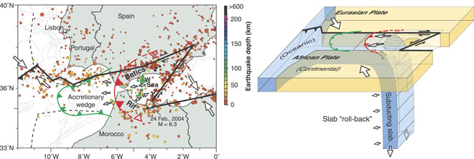
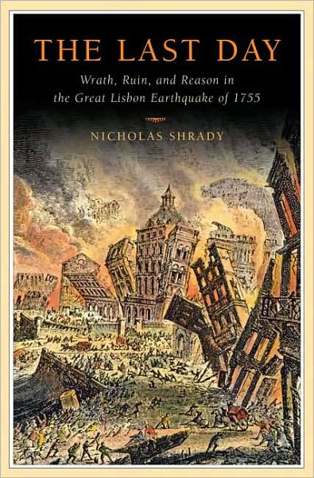
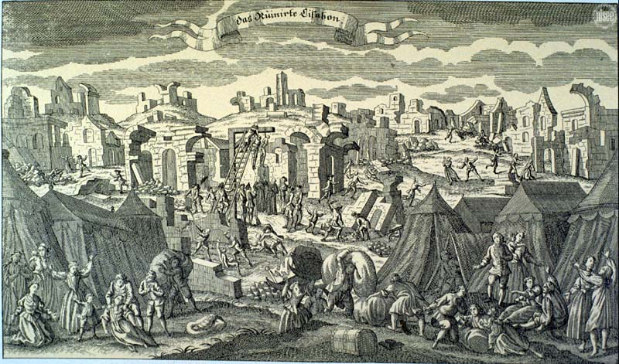
What Caused the M8.7 Great Lisbon Earthquake?

Slide 41



THE STILL UNSOLVED PROBLEM OF THE SOURCE OF THE 1755 M8.7 LISBON EARTHQUAKE

Slide 42

Messina, Sicily, 1908 (M7.2) – 72,000 deaths

Slide 43

CONTEMPORARY PRINT OF 1783 CALABRIA EARTHQUAKE

Slide 44



Slide 45

THE JANUARY 12 2010 HAITI EARTHQUAKE

Slide 46


Slide 47

LOCATION OF HISPANIOLA IN THE CARIBBEAN

Slide 48


Slide 49

HAITI AND ONTARIO ; PHYSICAL AND DEMOGRAPHIC COMPARISONS
AREA
HAITI – 27,750 sq km
ONTARIO – 1,076,395 sq km
POPULATION
HAITI = 9,035,536 (2009 estimate)
ONTARIO – 13,014,018 (2009 estimate)
POPULATION DENSITY
HAITI – 325.6 p/sq km
ONTARIO – 12.09 p/sq km

Slide 50

HAITI AND SOUTHWESTERN ONTARIO

Slide 51

SEISMOGRAM OF HAITI EARTHQUAKE RECORDED AT CALTECH SEISMOLOGICAL LABORATORY
M = 7.0; Depth = 13 km; Occurred at 4:53 pm Local Time

Slide 52

MAJOR TECTONIC PLATES AND LOCATION OF CARIBBEAN PLATE

Slide 53

TECTONIC SETTING OF JAN 12 HAITI EARTHQUAKE (M~7.0) – THE CARIBBEAN PLATE
[source – Demets et al. 2000]

Slide 54

THE CARIBBEAN PLATE ON GOOGLE EARTH

Slide 55

PAST IS PROLOGUE - EARTHQUAKES OF THE PAST (HISPANIOLA AND JAMAICA)
[source – Mann et al. 1995]

Slide 56


DESTRUCTION OF PORT ROYAL, JAMAICA IN 1692; AN EARLY HISTORICAL EVENT ON THE ENRIQUILLO-PLANTAIN GARDEN FAULT
[2,000 DEATHS]
[source – Taber, 1920]

Slide 57

Article by J. Scherer in Bulletin of the Seismological Society of America published in 1913

Slide 58

DESCRIPTION OF 1751 EARTHQUAKE
[source – Scherer, 1913]

Slide 59


DESCRIPTION OF 1770 EARTHQUAKE
[source – Scherer, 1913]

Slide 60

Shanty Towns
Densely populated
SETTING OF PORT AU PRINCE (New York Times)

Slide 61

Port-au-Prince; damage to downtown streets I

Slide 62

Port-au-Prince; damage to downtown streets II

Slide 63

Port-au-Prince; damage to downtown streets III

Slide 64

Port-au-Prince; damage to modern building on downtown street

Slide 65

Port-au-Prince; damage to Cathedral built between 1884 and 1914

Slide 66

Port-au-Prince; damage to shanty town areas II

Slide 67


Slide 69

See 9 articles in Special Issue of Nature GeoScience, November, 2010

Slide 70


EARTHQUAKES IN THE SUNDA TRENCH

Slide 71

PLATE TECTONIC SETTING OF THE 2004 M9.1 GREAT SUMATRA EARTHQUAKE, SUNDA TRENCH

Slide 72

THE SUNDA TRENCH SUBDUCTION ZONE

Slide 73

Dec 2004 (M9.1)
Mar 2005 (M8.6)
Sep 2009 (M7.6)
Oct 2010 (M7.7)

Slide 74

MARCH 28 2005 MEGATHRUST NAIS EARTHQUAKE (M8.6) – 2,000 deaths

Slide 75

Nalbant et al. 2005 (Nature, 435, p.756-757)

Slide 76

SEPTEMBER 2009 M7.6 SUMATRA EARTHQUAKE (~1,500 DEATHS)

Slide 77

2004 epicentre (M9.1)
2009 epicentre (M7.6)
2010 epicentre (M7.7)
LOCATION OF 2009 M7.6 WEST SUMATRA EARTHQUAKE IN SUNDA TRENCH

Slide 78

The southern Sumatra earthquake of September 30, 2009 occurred as a result of oblique-thrust faulting near the subduction interface plate boundary between the Australian and Sunda plates. At the location of this earthquake, the Australian Plate moves north-northeast with respect to the Sunda plate at a velocity of approximately 60 mm/yr. On the basis of the currently available fault mechanism information and earthquake depth of 80 km, it is likely that this earthquake occurred within the subducting Australian Plate rather than on the plate interface itself. The recent earthquake was deeper than typical subduction thrust earthquakes that generally occur at depths less than 50 km. The subduction zone surrounding the immediate region of this event has not witnessed a megathrust earthquake in the recent past, rupturing last in an earthquake of M 8.5 or larger in 1797. Approximately 350 km to the south, a 250 km section of the plate boundary slipped during an Mw 8.4 earthquake in September 2007, while approximately 300 km to the north, a 350 km section slipped during the Mw 8.7 earthquake of March 2005. In early 2008, the plate boundary updip of today’s earthquake was active in a sequence of Mw 5-6 earthquakes. It is not clear how today’s earthquake is related to the sequence of megathrust subduction zone events on the shallower section of the plate boundary.
Tectonic summary from USGS

Slide 79
Heavy damage in Padang (60 km from epicentre)

Slide 80

Earthquake triggered many landslides that buried several villages

Slide 81


Slide 82


Slide 83

Damaged market in Padang

Slide 84
2004 epicentre (M9.1)
LOCATION OF 2010 M7.7 MENTAWAI EARTHQUAKE IN SUNDA TRENCH

Slide 85

The Pulau Pagai Selatan, Sumatra earthquake of October 25, 2010 occurred as a result of thrust faulting on or near the subduction interface plate boundary between the Australia and Sunda plates. At the location of this earthquake, the Australia Plate move north-northeast with respect to the Sunda plate at a velocity of approximately 57-69 mm/yr. On the basis of the currently available fault mechanism information and earthquake depth it is likely that this earthquake occurred along the plate interface. The subduction zone adjacent to the region of this event last slipped during the Mw 8.5 and 7.9 earthquakes of September 2007, and today's event appears to have occurred near the rupture zones of those earthquakes. Today's earthquake is the latest in a sequence of large ruptures along the Sunda megathrust, including a M 9.1 earthquake that ruptured to within 800 km north of this earthquake in 2004; a M 8.6 700 km to the north between Nias and Simeulue in 2005; and a M 7.5 300 km to the north near Padang in 2009. Today's earthquake occurred near the southern edge of a Mw 8.7-8.9 rupture in 1797 and within the rupture area of a Mw 8.9-9.1 earthquake in 1833.
Tectonic summary from USGS

Slide 86

EARTHQUAKE GENERATED A SIGNIFICANT TSUNAMI WHICH STRUCK SOUTHERN MENTAWAI ISLANDS DESTROYING MANY VILLAGES (DEATH TOLL ~ 500)

Slide 87

EARTHQUAKE GENERATED A SIGNIFICANT TSUNAMI WHICH STRUCK SOUTHERN MENTAWAI ISLANDS (CIRCLED) DESTROYING MANY VILLAGES (DEATH TOLL ~ 500)

Slide 88

TSUNAMI FROM MENATAWI EARTHQUAKE; PROPAGATION SPEED IN OPEN OCEAN ca. 70 m/s

Slide 89
EARTHQUAKE DISASTERS (>50,000 DEATHS) 856-2010 (n = 22)
1 | 1566 | Shaanxi, China (M~8.0) | 830000
2 | 1976 | Tangshan, China (M7.5) | 255,000
3 | 1138 | Aleppo, Syria (strike slip) | 233,000
4 | 2010 | Haiti (M7.0 – strike slip) | 230,000
5 | 2004 | Sumatra (M9.1 - megathrust) | 227,898
6 | 856 | Damghan, Iran (strike slip) | 200,000
7 | 1920 | Haiyuan, China (M8.6 – strike slip) | 200,000
8 | 893 | Ardabil, Iran | 150,000
9 | 1923 | Kanto, Japan (M7.9) | 142,800
10 | 1948 | Ashkhabad, Turkmenistan (M7.3) | 110,000
11 | 1290 | Chihli, China | 100,000
12 | 2008 | Wenchuan, China (M7.9) | 87,587
13 | 2005 | Pakistan (M7.6) | 86,000
14 | 1667 | Caucasus (Shemakha, Azerbaijan) | 80,000
15 | 1727 | Tabriz, Iran | 77,000
16 | 1908 | Messina, Italy (M7.2) | 72,000
17 | 1755 | Lisbon, Portugal (M8.7) | 70,000
18 | 1970 | Chimbote, Peru (M7.9 – subduction) | 70,000
19 | 1268 | Asia Minor (Cilicia, Turkey) | 60,000
20 | 1693 | Sicily (M7.5) | 60,000
21 | 1783 | Calabria, Italy (sequence) | 50,000
22 | 1990 | W. Iran (M7.4) | 50,000
 |  |  | 3441285

Slide 90

EARTHQUAKE DISASTERS AT THE MARGINS OF THE ARABIAN PLATE

Slide 91
EARTHQUAKES AT THE MARGIN OF THE ARABIAN PLATE

Slide 93


Table 3.1

Slide 94


HISTORICAL SEISMICITY ON THE CENTRAL DEAD SEA TRANSFORM: A-1900-2002, B-HISTORICAL EARTHQUAKES IN LAST 1500 YRS (after Heidbach & Ben-Avraham, 2007)

Slide 95



1138 ALEPPO EARTHQUAKE, DEAD SEA TRANSFORM, SYRIA

Slide 96

Aleppo, February 19, 2013

Slide 97




Slide 98





Slide 99

LOCATION OF EARTHQUAKE EPICENTRES

Slide 101

POPULATION DENSITY OF THE WORLD (persons/sq km)
WHERE PEOPLE ARE – WHERE PEOPLE ARE NOT

Slide 102


